Slide 1

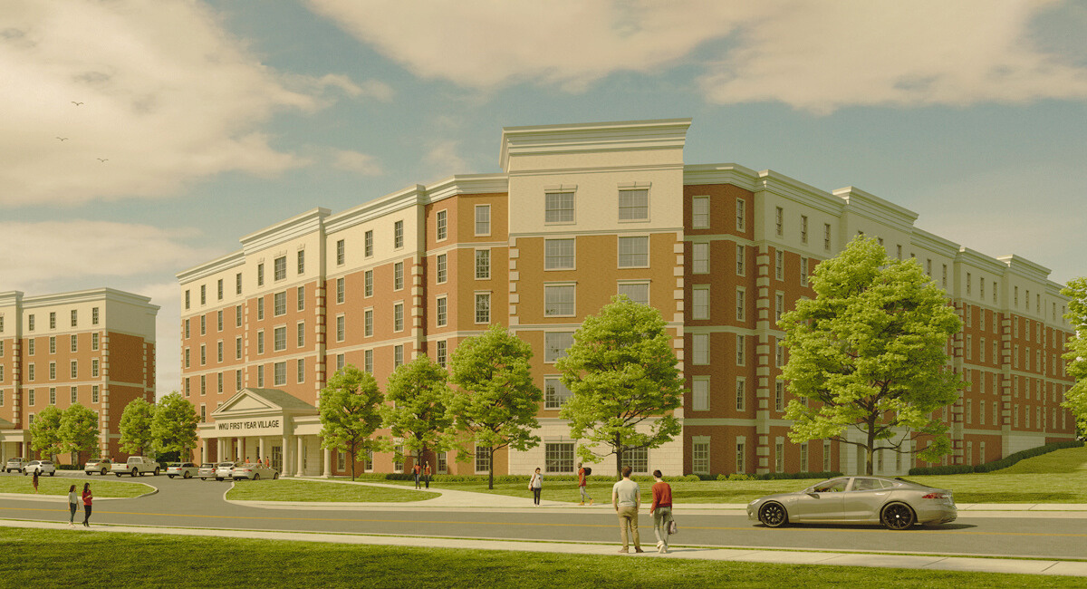
First-Year Student Engagement for Thriving and Success: Business Living Learning Communities
-
01
Dr. Evelyn Thrasher, Western Kentucky University
Dr. Christopher Shook, University of Alabama at Birmingham
02

Slide 2

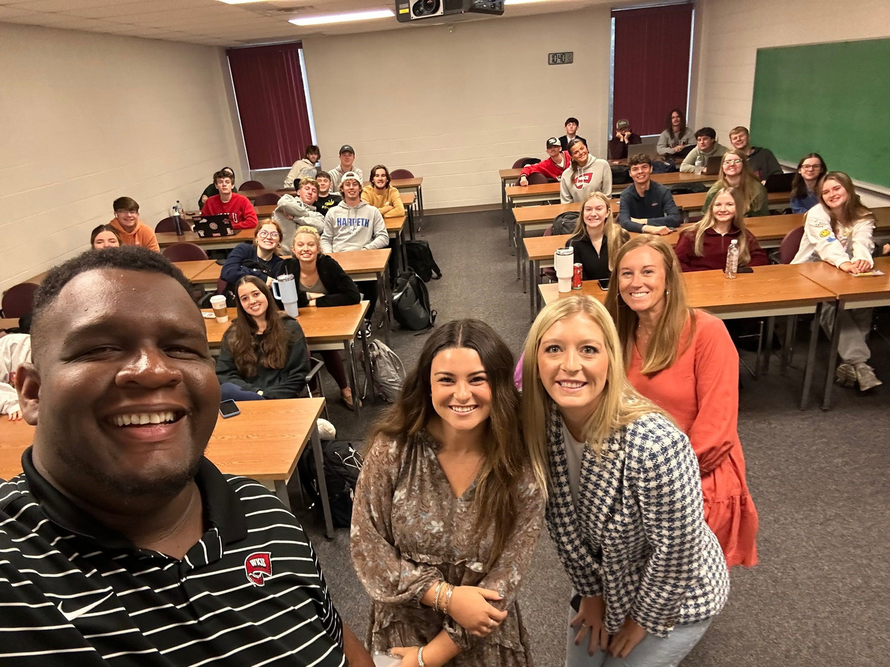
Agenda
LLC Definition
Program Goals
Timeline
Lessons Learned
Best Practices
Outcomes
01
02
03

Slide 3
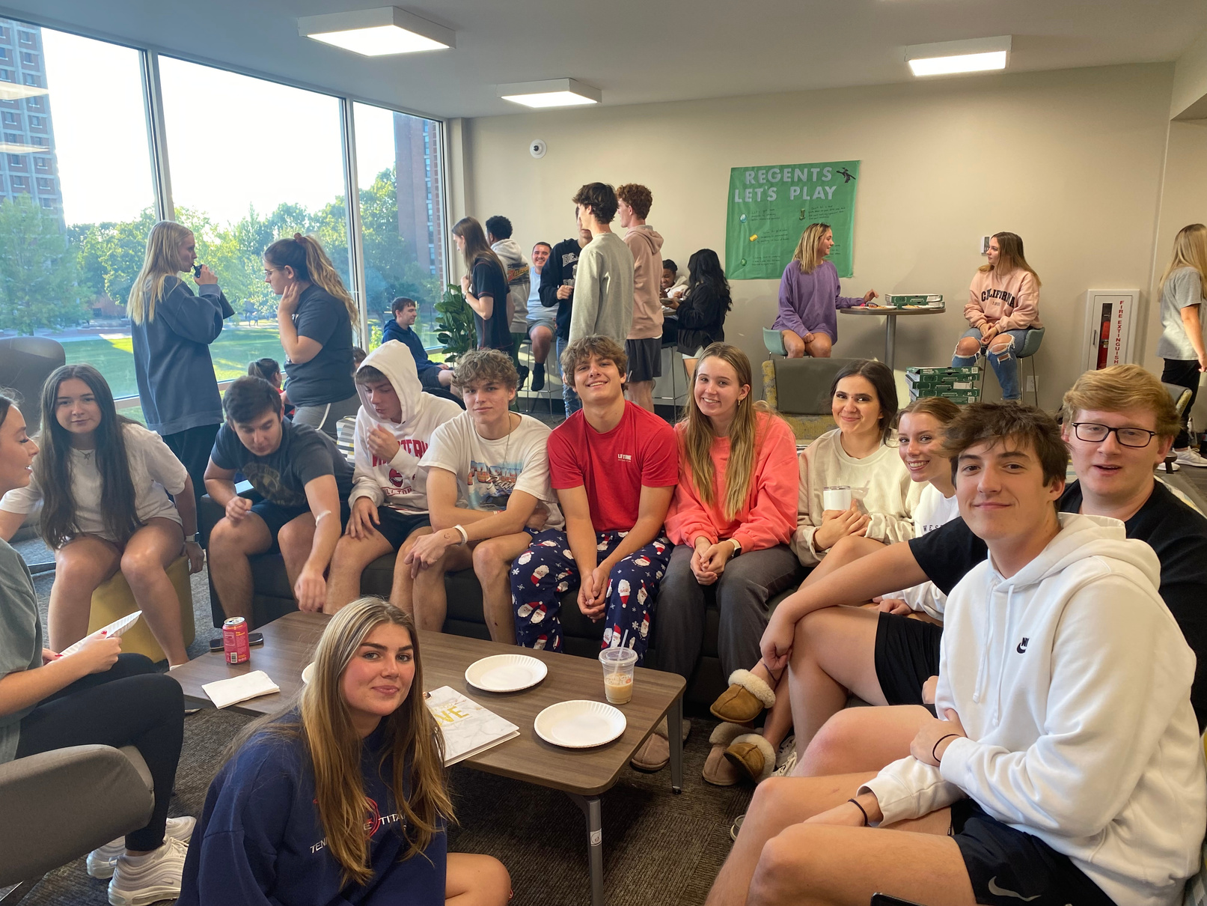
LLC Definition
Living Learning Communities (LLC) are residential programs that bring together students with similar academic or social interests to live together, take classes together, and participate in activities tailored to their majors or interests.
02
03
04

Slide 4
LLC Goals
The Living Learning Community should help students chart a course for success at the university.
01
02
03
Connect Socially
Succeed Academically
Engage with Faculty, Staff, and Administrators
07
08
09

Slide 5
Timeline
2021-2023
72 students per year
Led by Staff
Freshman Village
2020-2021
25 Students
Led by Faculty
2023-2024
96 Students
Led by Staff
Freshman Village
LLC Resident Assistants
04
05
06

Slide 6
Lessons Learned
  Be intentional
  Having an LLC will not automatically increase retention
  An LLC is a program, not just a residential option
  The cohort classes are an integral part of the program
05
06
07

Slide 7
Best Practices
  Develop effective collaboration between the college and housing
  Select the right college staff to lead
  Empower the staff to develop the selection process
  Design a year-long quality student experience
  Engage alumni in the program
  Create opportunities for LLC students and upper division students to get acquainted
  Employ former LLC students as resident assistants
  Involve the resident assistants in the program design
  Grow the LLC intentionally with a focus on quality over quantity
05
06
07

Slide 8
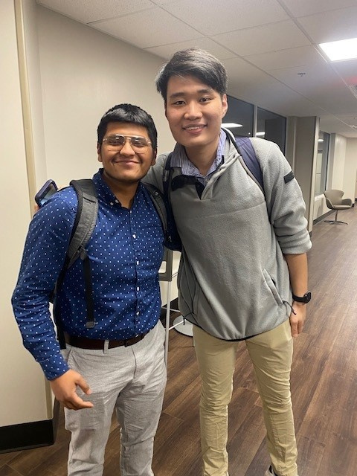
Outcomes
2021 Cohort Retention
 | Non-LLC | LLC
One Semester | 84.2% | 86.0%
One Year | 66.7% | 80.7%
Third Semester | 64.9% | 75.4%
2022 Cohort Retention
One Semester | 84.3% | 98.0%
One Year | 68.6% | 94.1%
13
14
15

Slide 9
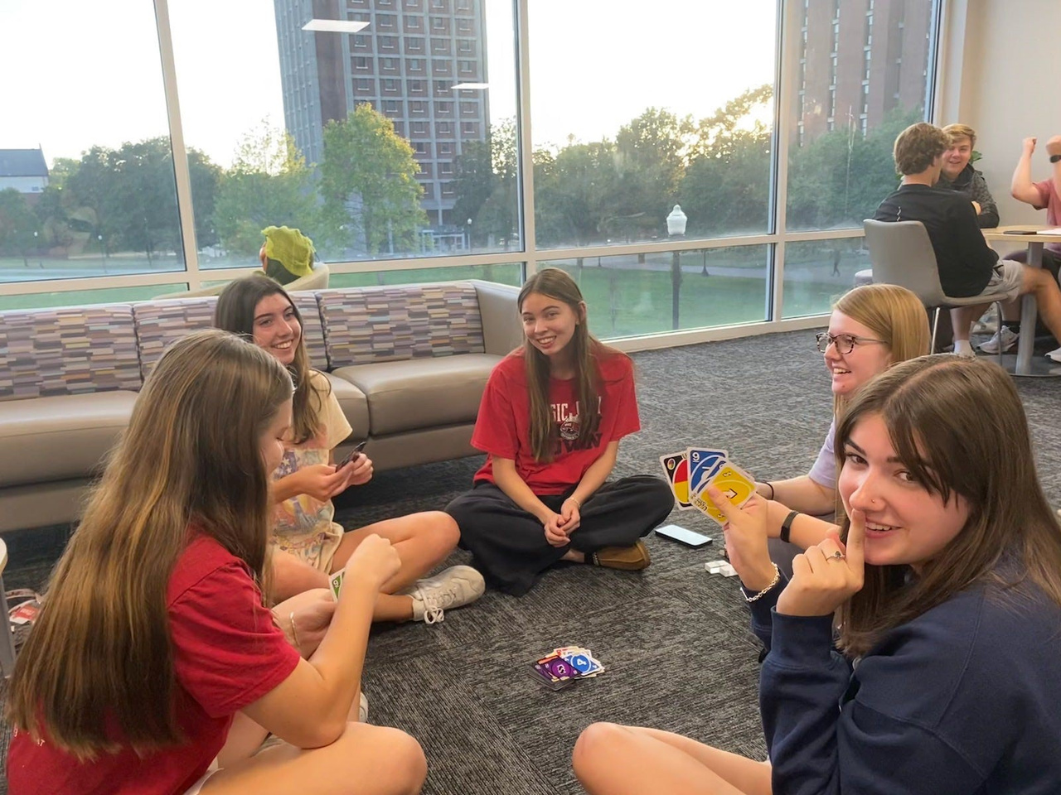
Questions
14
15
-

