Slide 1
Reimagining the Value of the Norris-Vincent College of Business:
Enabling Technologies and Creative Collaborations
Ruben Ceballos, Ph.D., MBA Director
Rex Moody, Ph.D., Department Chair of Management & Marketing
Andrew Tiger, Ph.D., Dean
Norris-Vincent College of Business

Slide 2
Agenda
Norris-Vincent College of Business
Enabling Technologies – Skills that students can list on their resume
Creative Collaborations – Internal and external partnerships

Slide 3
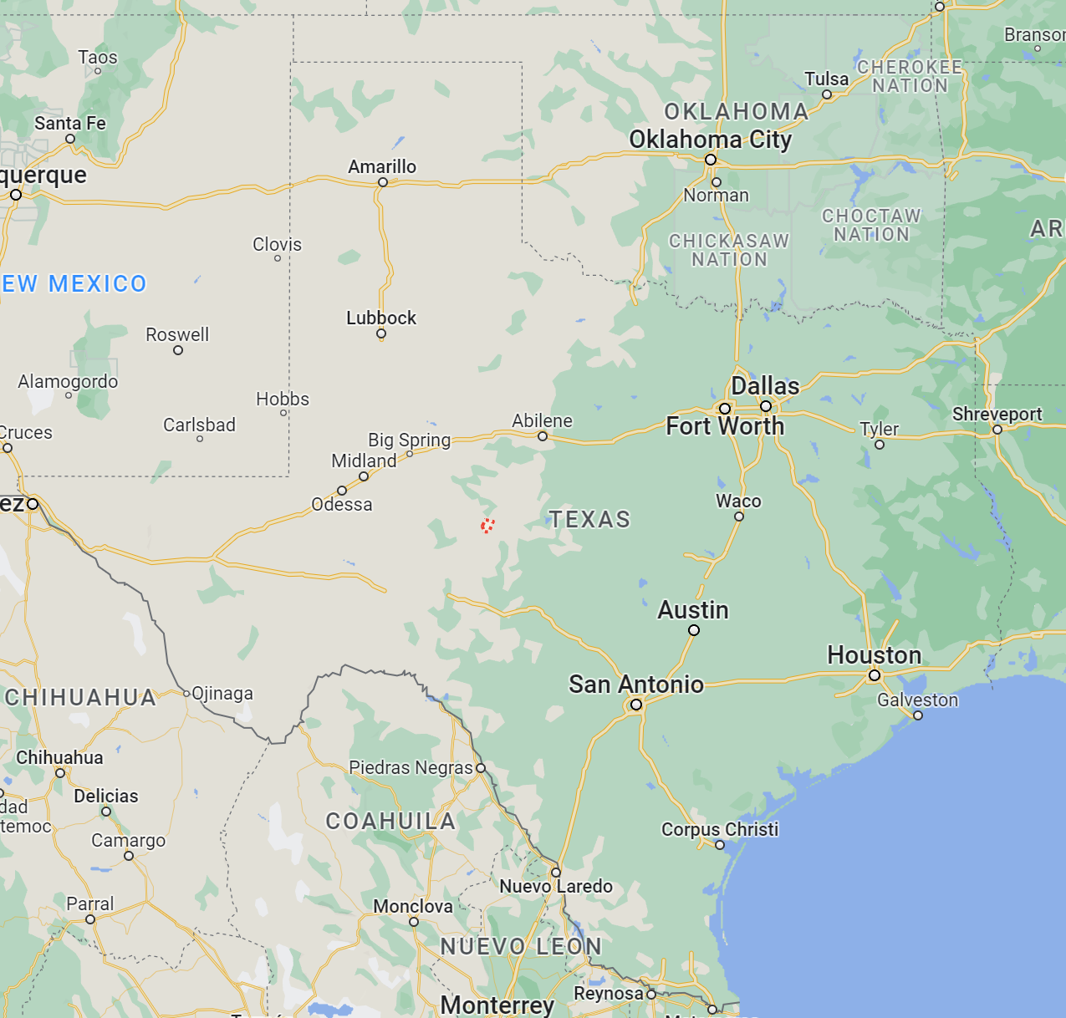
Norris-Vincent College of Business
San Angelo, TX (pop. 101,400)
Initial AACSB accreditation November 2021
970 undergraduates; 225 graduates
20 tenured/tenure track faculty; 6 full-time instructors
Three departments: MM, AEF, and Aerospace Studies/ROTC
7 BBA + CAV; MBA, MPAc; MSBDSA; MSHHFA (F23)
SBDC
Commercial Aviation (130 students in Fall 23)

Slide 4
Reimagining the ASU Marketing Major with Enabling Technologies
GOAL - Our goal is to add knowledge and technology tools to the ASU marketing degree so that all graduates learn skills that employers seek.
Teach skills that students can list on their resume.
Integrate skills in existing courses (vs. standalone skill-specific courses)

Slide 5
Technology Integration
Business Statistics – business core class
100% Excel-based
Laptops required (Windows/Mac – no Chrome books)
Business Analytics – (soon-to-be) business core class
Excel, Tableau, R
Consumer Behavior – major course
Qualtrics and MTurk
Digital and Social Media – major course
Stukent – social media marketing simulation
Future - SalesForce

Slide 6
Reimagining with Creative Collaborations
Excellence-in-Banking certificate
Master of Science in Business Data Science and Analytics
Master of Science in Hospital and Health Care Facilities Administration (subject to THECB approval)

Slide 7
Excellence-in-Banking Program (F23)
High demand for community bankers in region
Patterned after Texas Tech’s EIB program
Banking certificate (or minor)
Internships
Director (0.50 FTE)
High participation from banking partners (currently 10 banks and the Texas Banker’s Association)
Goal: raise $1MM endowment

Slide 8
Master of Science in Business Data Science and Analytics (MS BDSA)
Partnered with Computer Science department (not in business college)
Combine existing MBA courses and MSCS courses
30 credit hours: 5 MBA courses / 4 MSCS courses / 1 elective
100% online
Launched Fall 2022; Enrollment: 27
To do – Add a project-based capstone course

Slide 9
Master of Science in Hospital and Health Care Facilities Administration
Driven from the need to develop future healthcare administrators.
Three healthcare provider partners (current)
Seven MBA courses
Nine hours (3 courses) of in person Administrative Residency with one of our partners: 20 hours per week
30 total credit hours / 12 months
A program fee will be charged for the 3 residency courses that will generate $7,000 per course
Upon graduation, high expectation for student to join partner

Slide 10
Thank you! Questions?

