Slide 1
Recruitment & Retention Initiatives Needed in Higher Education
SBAA – July, 2023

Slide 2
WHY ARE WE DECLINING?

Slide 3
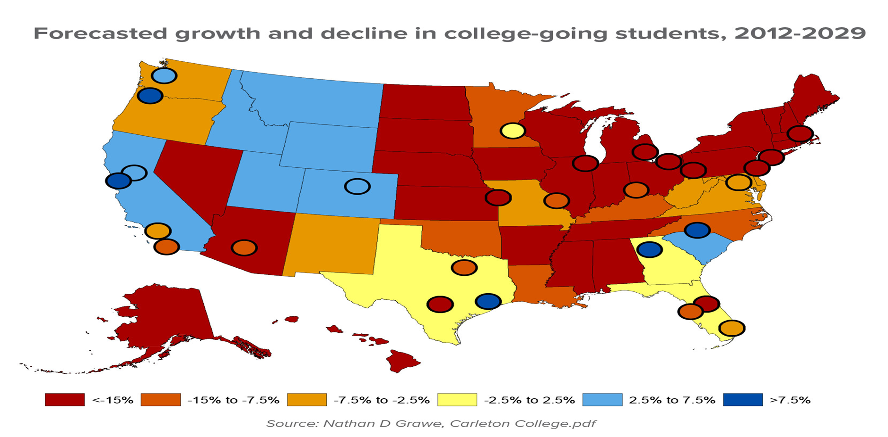
Notes:
Dr. Nathan Grawe, Carleton College, 2012

Slide 4
Fewer Students in High School 15.5M in 2023 : 14.7M in 2028
Fewer Students Going to College
68% in 2018 : 61% in 2023 Trend predicted until 2030
College-bound students in 2018 – 10,900,000
College-bound students in 2023 – 9,500,000
College-bound students in 2028 - 5,150,000
Notes:
U.S. Department of Education website

Slide 5
Gen X
Age: 47-58
Income: 51% are over $100k (household)
College: 10% didn’t graduate HS
25% will not attend college
17% will attend but not finish college
48% will obtain a college degree
Status: 64% are married (38% have children)
77% are employed; 73% own homes
Notes:
2023 Higher Education Study

Slide 6
Gen X
Use social media 12 hours per week
Newspaper, LinkedIn, Twitter
Use streaming audio
iHeartRadio, Audible, iTunes

Slide 7
Millennials
Age: 27-46
Income: 57% are over $75k (household)
College: 10% didn’t graduate HS
25% will not attend college
15% will attend but not finish college
50% will obtain a college degree
Status: 52% are married (57% have children)
79% are employed; 55% own homes

Slide 8
Millennials
Use social media 17 hours per week
Snapchat, Tiktok, Instagram
Use streaming audio
Facebook Watch, Disney+, Spotify

Slide 9
Gen Z
Age: 18-26
Income: 40% are under $50k (household)
College: 15% didn’t graduate HS
42% will not attend college
23% will attend but not finish college
20% will obtain a college degree
Status: 52% are married (42% have children)
62% are employed; 46% own homes

Slide 10
Gen Z
Use social media 24 hours per week
Snapchat, Tiktok, Instagram
Use streaming audio
Apple Music, Spotify

Slide 11
Understand Your Prospective Customer (Students)

Slide 12
How Do Millennials and Gen Z View Higher Education
40% - Means to satisfy their passion 39% - Path for career growth 69% - Online has the same quality as F2F 33% - Select school based on online offerings 84% - Research schools on YouTube

Slide 13
Associate Degree Seekers
36% - Seeking business-related credential 30% - Seeking STEM-related credential 54% - Affordability is a top concern 53% - Flexibility of offerings is a top concern 61% - Choose an institution in 3-6 months
Use YouTube, Facebook, Instagram, TV to choose Desire Emails and Streaming Videos from schools

Slide 14
Bachelor Degree Seekers
35% - Seeking business-related credential 41% - Seeking STEM-related credential 58% - Affordability is a top concern 56% - Job placement rate of institution important 51% - Choose an institution in 3-6 months 25% - Choose an institution in less than 3 months
Use Facebook, YouTube, and Instagram to choose Desire Emails and Streaming Videos from schools

Slide 15
Graduate Degree Seekers
40% - Seeking business-related credential 41% - Seeking STEM-related credential 56% - Affordability is a top concern 54% - Flexibility of courses is very important 50% - Choose an institution in 3-6 months 28% - Choose an institution in less than 3 months
Use Facebook, Instagram, YouTube to choose Desire Emails and Streaming Videos from schools

Slide 16
Transfer Students
37% - Desire STEM-related credentials
34% - Desire Business-related credentials
70% - Desire to transfer for B.S.
13% - Desire certificate or other Microcredential
51% - Affordability is #1 concern
Job Placement upon completion is #2
Search for institutions on YouTube, TV, and FB

Slide 17
Transfer Students
Age: 23 (60% Female/40% Male)
Income: 33% under $50k
Status: 19% are married (38% have children)
62% are employed; 53% own homes
Use social media 21 hours/week
Snapchat, TikTok, Instagram
Spotify and Apple Music

Slide 18
Why Does Retention Matter?

Slide 19
Why Does Retention Matter?
Tuition as a percentage of total revenue is increasing Some state’s funding is based on retention rates At my institution, every 100 students = $1,000,000

Slide 20
Why Does Retention Matter?
Social Mobility of the Students
Reputation of the University
Fewer Class Sections Offered
More Non-Viable Programs
FEWER FACULTY NEEDED!

Slide 21
What is Good Retention?
The national retention rate of FT students is 71% Private institutions perform better than public (74%/67%) 4-year institutions perform better than 2-year (73%/64%) Most students are lost between FR/SOPH years (25%)
Notes:
U.S. Department of Education

Slide 22
Retention at Southern Public Institutions
71%
61%
60%
69%
67%
66%
65%
62%
Missouri
Florida
Tennessee
Alabama & Kentucky
Mississippi
Arkansas
Georgia
Louisiana
Notes:
Individual State Department’s of Higher Education

Slide 23
Why Do They Leave?

Slide 26
What Can We Do?

Slide 27
Academic Issues
Proactive Outreach and Support
Holistic Student Support
Build a Sense of Community/Belonging

Slide 28
Personal/Transitional Issues
Personalized Support Programs Mental Health Initiatives Peer Support Groups More Accommodations and Flexibility

Slide 29
Family Issues
Flexible Academic Support Time Management Assistance Encourage Counseling

Slide 30
Financial Issues
Financial Aid Education Program Financial Literacy Program More Student Employment

Slide 31
Other Issues
Cohort Groups
More Student Engagement Activities
More Flexible Course Scheduling
More Seamless Registration Process
Specialized Support Based Upon Demographics
More Timely Feedback from Instructors
More Proactive with Endangered Students

Slide 32
Who Should Play a Part in Retention?
EVERYONE!

Slide 33
RETAIN!
Expansion of Hyflex/Online Course and Program Delivery
Expansion of Micro-credentials
College-based Retention Initiatives
Curriculum Renewal
1
3
5
6
2
4
6
Expansion of OER/Zero Cost Textbooks
Improved Experience for Transfer Students
Expansion of Prior Learning Assessment

Slide 35
Questions?

