Slide 1
Improving the Academic Project Experience: Agile Project Management
Hari K Rajagopalan

Slide 2
Introduction
University
School of Business
Vision
Be the resource for Business education for the region
4000 students
Undergraduate, Graduate and Professional Doctorate
600 students
College of Liberal Arts and Sciences, and three professional Schools
Undergraduate, Professional, MBA

Slide 3
Impact of Teaching
How to deliver Exp. Learning
Simulation and Case studies
Internship and Student led businesses
Student Consulting Projects
There is more to teaching than just a lecture
Experiential Learning is an important aspect of teaching

Slide 4
Student Projects
Process
Faculty gives the project at start
Result
Poor presentation and reports
Tell students to come to them if they have any questions
Students scramble to finish it at the end of the semester
Unrealistic decision making
Free loading
Poor outcomes

Slide 5
Reasons
Faculty Role
Very little faculty interaction
Faculty provide inputs
Project Management
Students have little or no experience
Wait till the last minute
Teamwork
Team of peers
Difficult to manage their peers
No context
No depth of knowledge
Poor outcomes

Slide 6
Solution
Use a real client
Implement Agile Project Management
Instructor takes on the role of project manager or scrum master

Slide 7
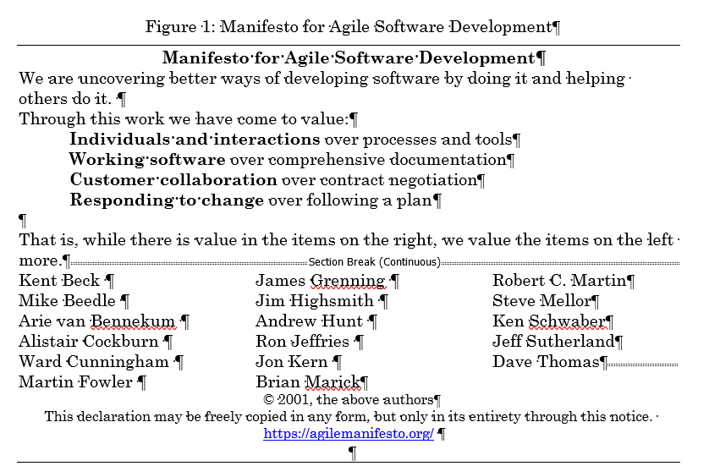
Agile Software Development Manifesto

Slide 8
Agile Project Management
Minimize risk by focusing on short iterations of clearly defined deliverables.
Communicate directly with partners in the development process instead of creating copious documentation

Slide 9
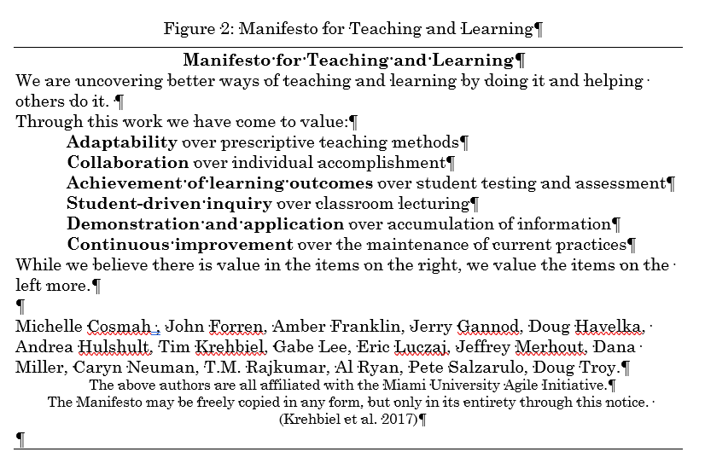
Agile Manifesto for Teaching and Learning

Slide 10
Implementation
Supply Chain Analytics
Juniors and Seniors
8 – 12 students
Excel based class

Slide 11
Design of the Semester
Phase 1: Introduction to the Company and Product Strategy
Exam 1: Forecasting
Presentation 1: Product Strategy
Phase 2: Forecasting
Exam 2: Aggregate Planning
Presentation 2: Forecasting
Phase 3: Aggregate Planning
Exam 3: Other Material
Presentation 3: Aggregate Planning
Final Phase: Integration
Final Presentation
Final Report

Slide 12
Problems with the Class
Unrealistic decision-making
Poor presentations
Dysfunctional team processes

Slide 13
Agile Project
Scrum Team
Create goals and plan for each sprint
Sprints
Project divided into weekly sprints
Each team needed to meet with the professor either face to face or on Zoom
All students in a team must meet the professor weekly
Adapt plan, hold each other accountable
Completing weekly deliverables

Slide 14
Agile Project
Scrum Master
Professor is the project manager
Responsible for each team's effectiveness
Also helps in team dynamics
Product Owner
Client or Product Owner
Responsible for interacting with the scrum team
Developing and communicating the data needed
Giving feedback

Slide 15
Problems and Solutions
Problem | Solution | Intended Outcome
Unrealistic decision-making | Live client; Agile with Scrum | Increased comfort with real-world decision-making tradeoffs
Poor presentations | Agile with Scrum | Improved presentation skills including confidence and familiarity with content
Dysfunctional team processes | Agile with Scrum | Increased team communication, accountability

Slide 16
Example of Improvement
Scrum Team: …therefore, if we allow hiring and firing of workers, we can layoff “X” workers in months 2, 4 and 6 and hire “Y” workers in months 3 and 9. This will save us “Z” million dollars.
Client: Your forecast predicted a surge in demand due to everyone staying at home with COVID restrictions and ordering more of the product. Is that correct?
Scrum Team: Yes, that’s correct. Our forecast indicates that demand will increase by “A” % and our MAPE is “B” %.
Client: Given that we are anticipating this huge surge in demand and that we have difficulty hiring skilled workers, do you think hiring and firing workers monthly is a realistic scenario?

Slide 17
Client feedback
“The biggest evidence of [better decision-making] is the different scenarios that they're presenting. [Students now say] 'Hey, here are four or five scenarios. And here is the one we recommend for these reasons. And if you were to choose, say, scenario three, then here are the pros and cons.'...It's their ability to take the conversations they're having with us, and develop a range of options, and then apply those. [Students say] 'So scenario three is the best for the business because of X. X fits the strategy, this is a short-term market concern, so therefore, you should go with this scenario.' So, the depth and breadth of the scenarios that they're able to speak to is perfect evidence of what they're getting out of the interactions”

Slide 18
Student feedback
“We had to change our model like sixteen different times in order to fit the aggregate planning scenarios and work with the error rates and everything”
“I did not think I would learn anything useful from college, but everyone said I needed a college degree, but I saw all these managers listening to me and asking questions.. Suddenly, it hit me.. This is real”
“The most important thing I learned from this project is that there is no right answer. All our classes make us give one answer, here there is no right answer, every scenario has its drawbacks, and we always have to pay some price”

Slide 19
Future plans and Questions
Get faculty certified in agile and as scrum masters
Find ways to scale this to larger classes
Incentivize faculty to work on these student consulting project
Going back to mission, if you value teaching what are you incentivizing most ?

