Slide 1
ImpactX
Spearheading positive change in the community
Dave Wyman, Director of Entrepreneurship
Paul Schwager, Dean

Slide 2
About Business @ Charleston
Liberal Arts & Sciences College of ~11,000 students
Historic urban campus
Business:
9 undergraduate majors
10 minors
6 concentration areas
Honors Program
MBA (top 100 program)
MSA
Serve approximately 3,000 students

Slide 3
Community Engagement Throughout
Class Project: Real Estate analysis for investor purchase of non-profit
Class Project: Analysis of local Non-Profit
Class speakers: Major community benefactors and leaders of non-profits
Student visits to non-profits and government leaders
Turning Leaf, a leader develop program for felons
Charleston Digital Corridor
MBA Consulting Club works with local non-profits
Beach clean-ups
Impact internships (sponsored internship with non-profits)

Slide 4
What is ImpactX?
3-credit interdisciplinary class (ENTR 320)
Student teams create start-ups to solve community problems
Intentionally Interdisciplinary
Multiple cohorts per semester, 21 students per cohort
Includes an HONORS cohort
Expanding to include other specific cohorts (e.g., engineering)
Has a designated classroom, creating a short-term business incubator

Slide 5
Executive Engagement

Slide 6
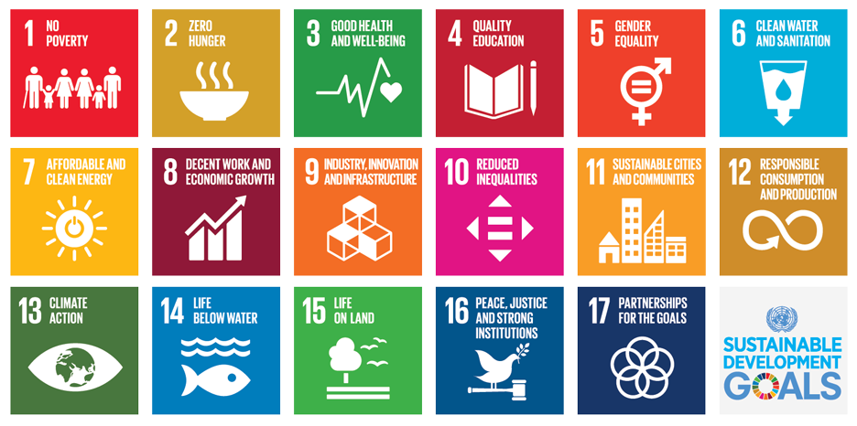
ImpactX: Signature Qualities
Guided by United Nations 17 Sustainable Development Goals with a twist to commit to “in-place impact” by solving problems in the local community.
Notes:
First, the heart of Impact X is creating startups focused on solving social and environmental problems guided by the United Nations 17 Sustainable Development Goals (SDGs). A special twist of Impact X is the application of the 17 SDGs to create “in-place impact” by solving problems in our local community. The focus on local problems and scalable solutions means the bigger the problem solved, the greater the impact; needless to say, we have a multitude of serious problems in our local community and beyond. Although students utilize the standard lean startup process, the focus on solutions encompassing people, planet, and profit differentiates the program from traditional entrepreneurship programs. In other words, purpose and passion are core elements of the Impact X paradigm.

Slide 7
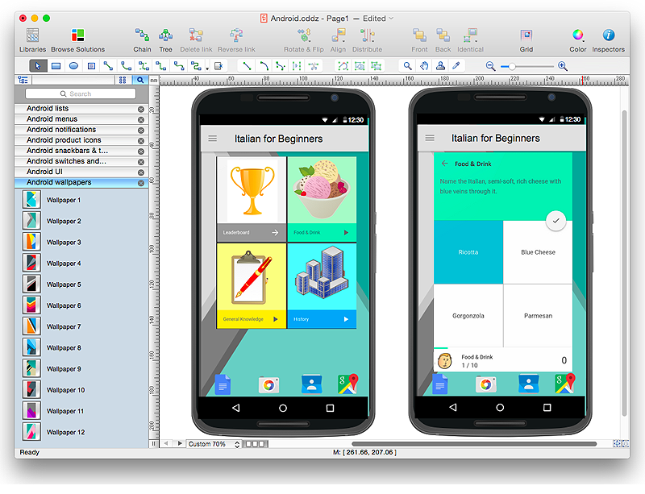
ImpactX: Signature Qualities
Guided by United Nations 17 Sustainable Development Goals with a twist to commit to “in-place impact” by solving problems in the local community.
Students learn to design and implement no-code apps and software development practices, like SCRUM.
Notes:
Second, in just one semester, students learn to design and implement no-code apps. The no code movement (utilizing software such as “Mock It” or “Just in Mind”) provides students with the experiential tools to test and validate minimum viable products with live potential customers. Students learn software development best practices, including scrum.

Slide 8
ImpactX: Signature Qualities
Guided by United Nations 17 Sustainable Development Goals with a twist to commit to “in-place impact” by solving problems in the local community.
Students learn to design and implement no-code apps and software development practices, like SCRUM.
Student teams are challenged to interview 100 potential customers, clients, and investors.
Notes:
Third, student teams are challenged to interview 100 potential customers, competitors, and suppliers. This is often the most difficult element of the program as the students are required to “get out of the building” and discuss real problems with constituents. Our secret sauce is we provide students access to a wide variety of mentors from the community, business, and technology sectors as well as professional contacts of our Social and Environmental Entrepreneur-in-Residence, Stuart M. Williams. As the saying goes, “no one of us is as smart as all of us.”

Slide 9
ImpactX: Signature Qualities
Guided by United Nations 17 Sustainable Development Goals with a twist to commit to “in-place impact” by solving problems in the local community.
Students learn to design and implement no-code apps and software development practices, like SCRUM.
Student teams are challenged to interview 100 potential customers, clients, and investors.
Each team is assigned a mentor from the Business Community
Notes:
Third, student teams are challenged to interview 100 potential customers, competitors, and suppliers. This is often the most difficult element of the program as the students are required to “get out of the building” and discuss real problems with constituents. Our secret sauce is we provide students access to a wide variety of mentors from the community, business, and technology sectors as well as professional contacts of our Social and Environmental Entrepreneur-in-Residence, Stuart M. Williams. As the saying goes, “no one of us is as smart as all of us.”

Slide 10
ImpactX: Signature Qualities
Guided by United Nations 17 Sustainable Development Goals with a twist to commit to “in-place impact” by solving problems in the local community.
Students learn to design and implement no-code apps and software development practices, like SCRUM.
Student teams are challenged to interview 100 potential customers, clients, and investors.
Each team is assigned a mentors from the Business Community.
ImpactX “graduates” come back as student mentors.
Notes:
Third, student teams are challenged to interview 100 potential customers, competitors, and suppliers. This is often the most difficult element of the program as the students are required to “get out of the building” and discuss real problems with constituents. Our secret sauce is we provide students access to a wide variety of mentors from the community, business, and technology sectors as well as professional contacts of our Social and Environmental Entrepreneur-in-Residence, Stuart M. Williams. As the saying goes, “no one of us is as smart as all of us.”

Slide 11
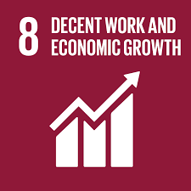
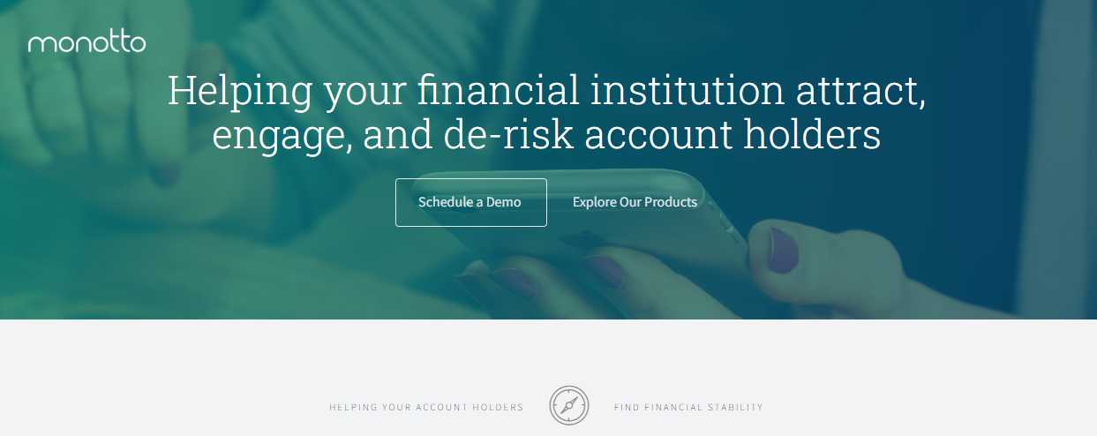
Monotto (‘16)
Mobile banking app
Raised over $250,000
Voted one of the top 3 fintech startups in Atlanta
Notes:
Monotto recently celebrated a liquidity event when acquired by Horicon Bank.

Slide 12
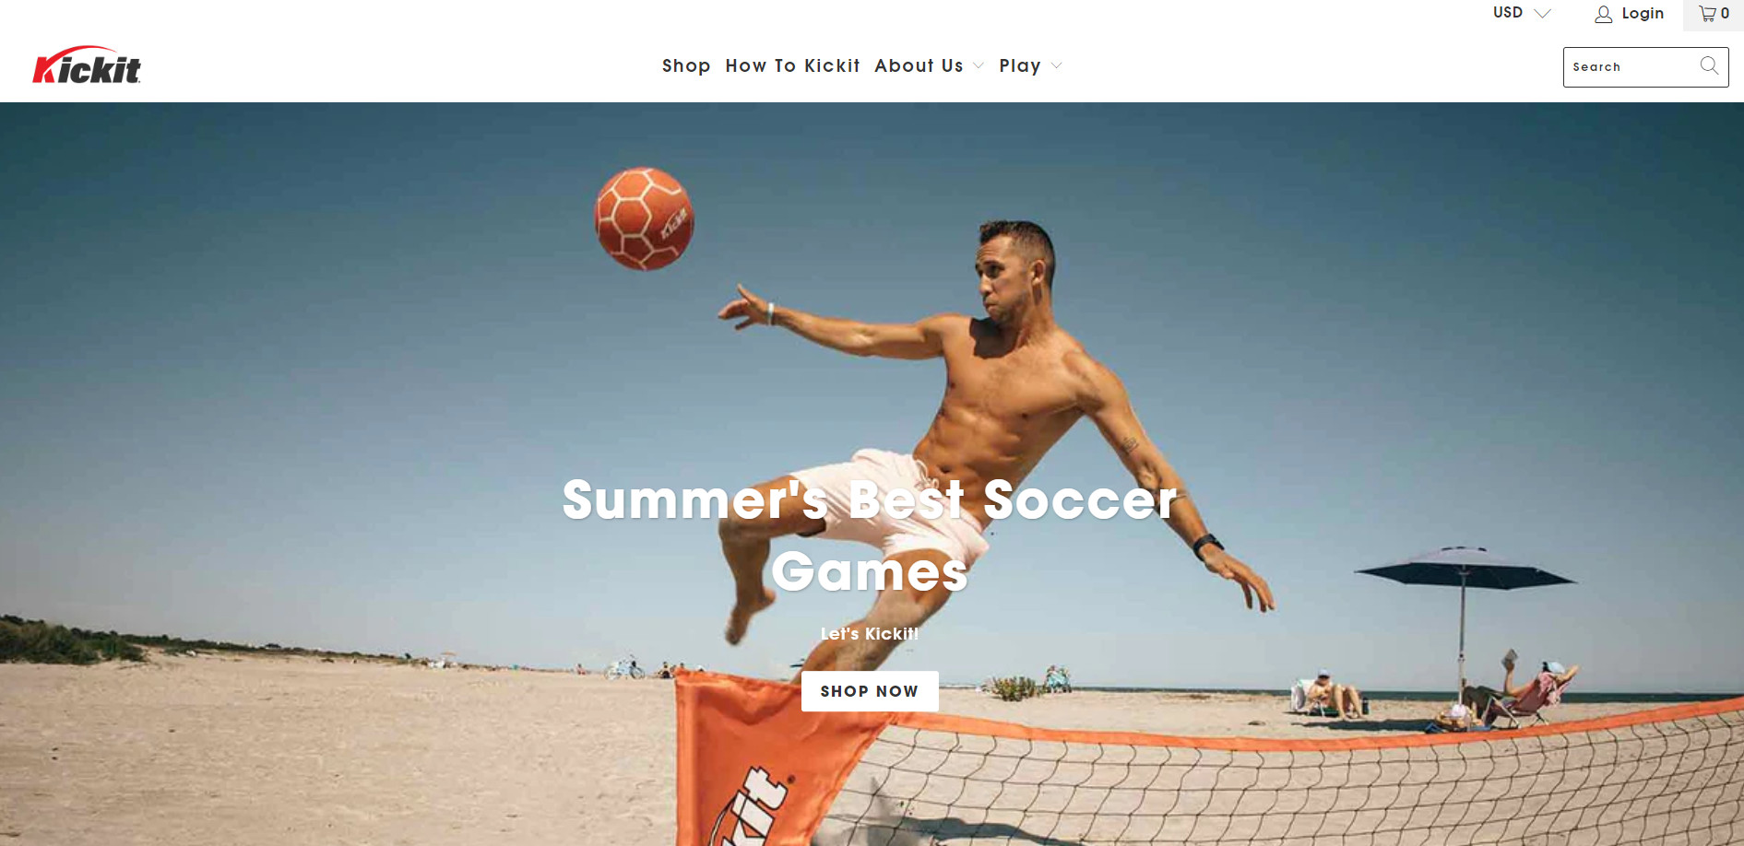
Kick-It (‘17)
Kick-It purposed to help youth fitness (kickit.net)
Notes:
Eli Dent founded Kick-It, (kickit.net/), purposed to help youth fitness (SDG #3)

Slide 13
Wisdom Mothers (‘17)
Wisdom Mothers interviewed at UN.
Notes:
Aggregates and evaluates after school programs in a community

Slide 14
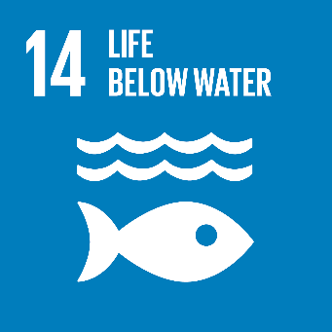
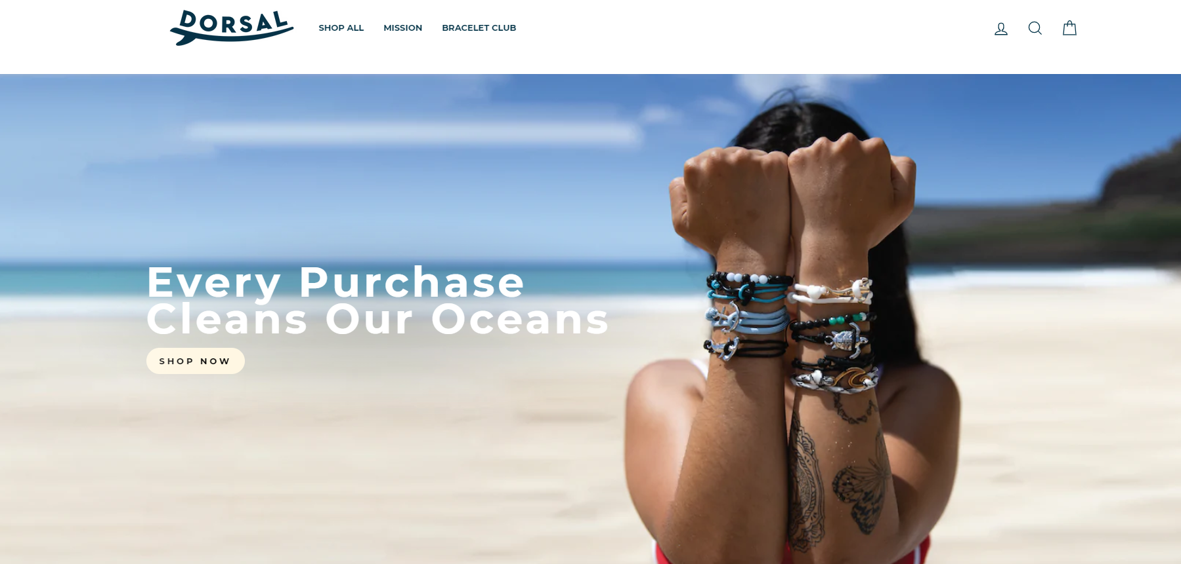
Dorsal Bracelets (‘18)
Purposed to remove 1 pound of ocean plastic with every purchase.
Notes:
Many students pivot to create different new ventures after graduation. Chad Ross

Slide 15
Tribe (’21) App to help prevent suicide among veterans

Slide 16
ImpactX Cohorts
Adaptable templates
Freshman Honors cohort - 15 students
ENTR 320 class - 21 and 35 students
3-credit or 6-credit teaching both entrepreneurship and technology
Fall 2023
Environmental Studies & Hospitality sections

Slide 17
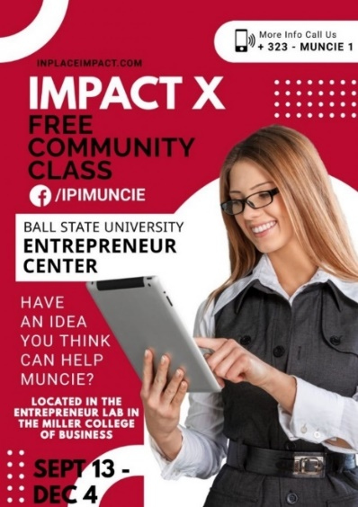
ImpactX: Beyond CofC
Charleston Community Class (‘19)
Local Jail (‘22)
Ball State (’22)
Notes:
Impact X community class with approximately 20 students. This class is specifically designed to help entrepreneurs from diverse communities create startups in their own local community. The success of the program has now spread its wings and the community class is being taught to 15 inmates in a local jail to provide them with skills and purpose to make a difference in their local communities.

Slide 18
ImpactX: Responsible Entrepreneurship

Slide 19
Building responsible
Impact Leaders
“You don’t build a business, you build people, and then people build a business.”
- Zig Ziglar
Notes:
Heart of Impact X Building responsible Impact Leaders
transforms entrepreneurship from experiential learning to consequential learning.

Slide 20
How can we help?
David Wyman, PhD
Associate Professor of Entrepreneurship
Director, The Center for Entrepreneurship
wymandm@cofc.edu
Paul Schwager, PhD.
Dean
schwagerph@cofc.edu

