Slide 1
The Hatband Exercise: The Politics of Silence and Voice
Craig L. Pearce
&
Bob G. Wood

Slide 2
Hatband Exercise
Your group is a mesh or personalities (indicated by the labels each is wearing.)
Terry, a member of the group, is absent. He has always been a strong contributor to the group. Lately, however, Terry, has been performing poorly, not communicating well and failing on the job.
The heck with the agenda. What do we do about Terry?
During the exercise, treat the other members of your group according to the labels they wear on their forehead.

Slide 3
Social Dynamics Debrief
Was your group effective at its task?
How did you feel about your role in the exercise?
How did you feel about the other members of the group during the exercise?

Slide 4
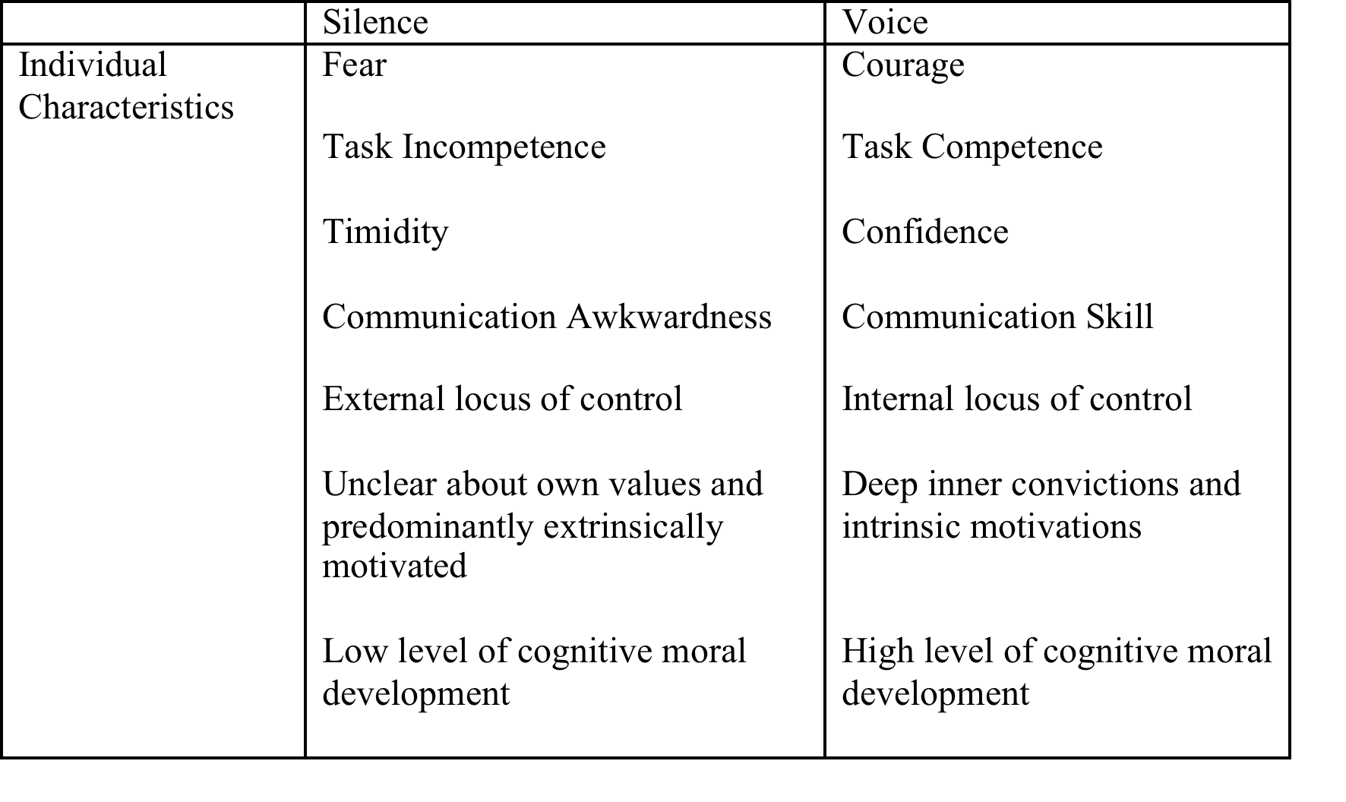
From Silence to Voice
Source: Pearce, C. L. & Wegge, J. (2015). Organizational Dynamics.

Slide 5
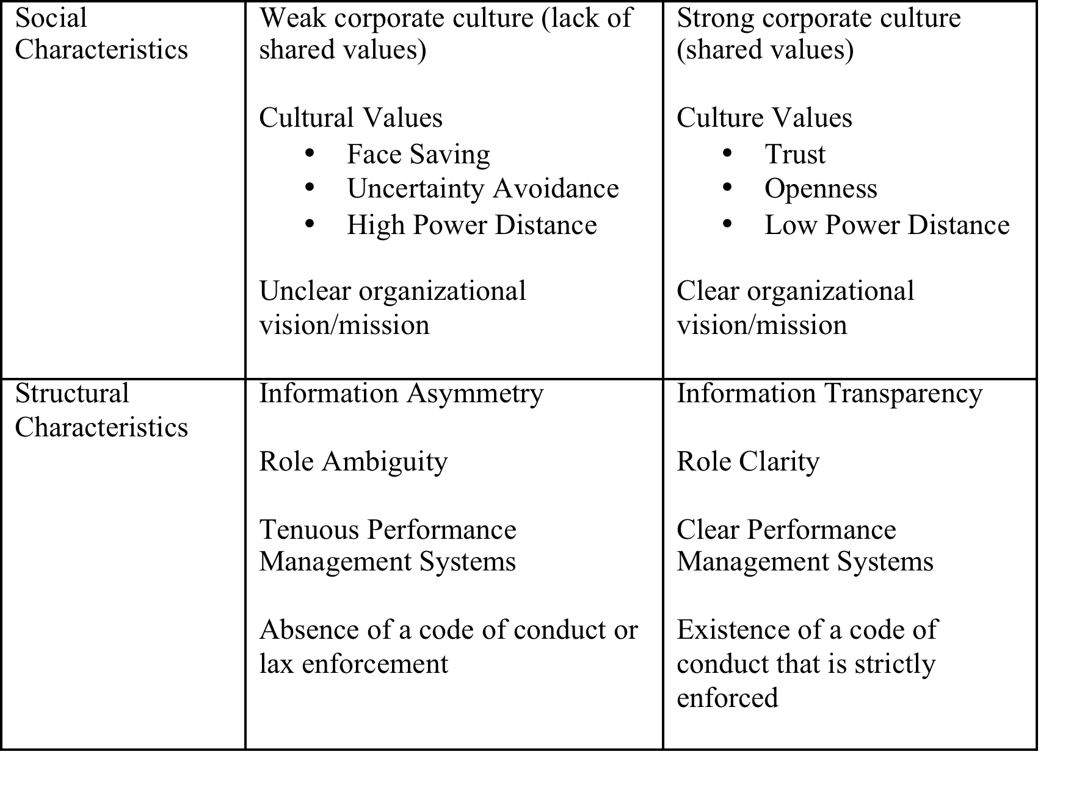
From Silence to Voice (page 2)
Source: Pearce, C. L. & Wegge, J. (2015). Organizational Dynamics.

Slide 6
From Shared Governance to Shared Leadership
Role of Faculty on: | Shared Governance | Shared Leadership
Ethical Standards | Compliance | Commitment
Decision Making | Source of Input | Source of Creation
Working with Others | Independence | Interdependence
Performance Rubric | Rules | Aspirations
Environmental Stimuli | Reactive | Proactive

Slide 7
The Voice-Shared Leadership-Responsibility Equation
Questioning Behavior at Odds with Organizational Values
Effective
Shared Leadership
Providing Direction
Appropriate
Organizational Voice
Sustainable Organizational Responsibility
Articulating Vision
Celebrating Success
Empowering Others
Identifying Potential Moral Dilemmas
Providing Technical Information to Bear on Decision Making
Representing Silent Constituents with Little Opportunity for Voice
Economic Sustainability
Environmental Sustainability
Emotional Sustanability
Source: Pearce, C. L. & Wegge, J. (2015). Organizational Dynamics.

