Slide 1
The Grand Communication Canyon
Filling The Business Communication Skills Education Gap
Robert T. Sumichrast: Dean, Pamplin College of Business, Virginia Tech
Kevin D. Carlson: Associate Dean for Research & Faculty Affairs
Steve C. Matuszak: Business Communication Education Coordinator
Instructor, MGT Dept.

Slide 2
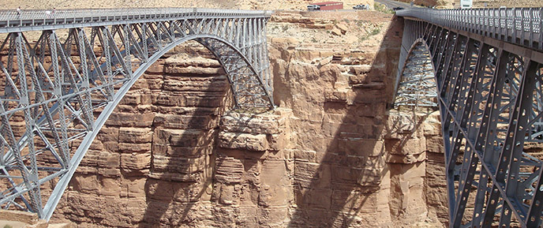
Welcome and Overview
Dr. Robert T. Sumichrast
Dean, Pamplin College of Business
Virginia Tech
https://www.nps.gov/glca/learn/historyculture/navajobridge.htm
1) Problem Framing Approach 2) Competencies 3) Assessment 4) Development

Slide 3
Framing the Problem
It is easy to say “students can’t communicate.” The real challenge in improving communication skills is understanding what that means.
1) Problem Framing Approach 2) Competencies 3) Assessment 4) Development

Slide 4
Framing the Problem
Systematically improving business students’ communication skills is a complex task.
Two realities increase the challenge:
Communication competence requires a broad constellation of component skills applied in diverse contexts
Students’ development needs differ
1) Problem Framing Approach 2) Competencies 3) Assessment 4) Development

Slide 5
Finding Solutions
Not surprisingly, creating undifferentiated education for different capable students rarely provides the necessary preparation.
Therefore, we seek alternative solutions.
1) Problem Framing Approach 2) Competencies 3) Assessment 4) Development

Slide 6
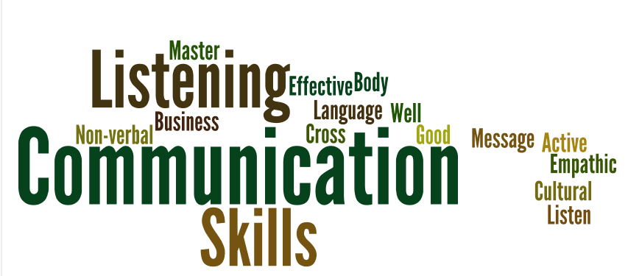
Communication Competence
*Place pictures, graphs and images here
Communication requires many skills.
What does it take to give an effective speech?
What does it take to write an effective proposal?
1) Problem Framing Approach 2) Competencies 3) Assessment 4) Development

Slide 7
A Complex Landscape
There are many aspects beyond specific skills.
Categories: Oral & Written
Within Oral: Speaking & Listening
Contexts: Academic, Society, Workplace
Settings: Public Speaking, Interpersonal, Team/Group,
Purposes: Disseminate, Persuade, Empower
Components: Knowledge, Skills, Motivation
Channels: Neutral to Rich
Technology: Mediated vs. Non-Mediated
Stakes: Low to High
*Place pictures, graphs and images here
1) Problem Framing Approach 2) Competencies 3) Assessment 4) Development

Slide 8
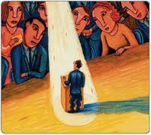
Communication Apprehension
“An individual’s level of fear or anxiety associated with either real or anticipated communication with another person or persons.” (McCroskey, 1977, p. 78)
*Place pictures, graphs and images here
Before, During, and/or After
Manifested in Three Dimensions:
Cognitive (Think Negatively)
Behavioral(Withdraw, Silence, Ineffective)
Physiological (Adverse Effects)
https://www.citelighter.com/communications/communications/knowledgecards/communication-apprehension-as-trait
1) Problem Framing Approach 2) Competencies 3) Assessment 4) Development

Slide 9
Communication Apprehension
Impedes:
Communication skills expression
Communication skills development
Domains
Within-individual differences
Differences between indiv’s
Differences within settings
On top of all the other complexity
1) Constellation of Skills
2) Variability of Students’ Skills
3) Communication Apprehension
*Place pictures, graphs and images here
1) Problem Framing Approach 2) Competencies 3) Assessment 4) Development

Slide 10
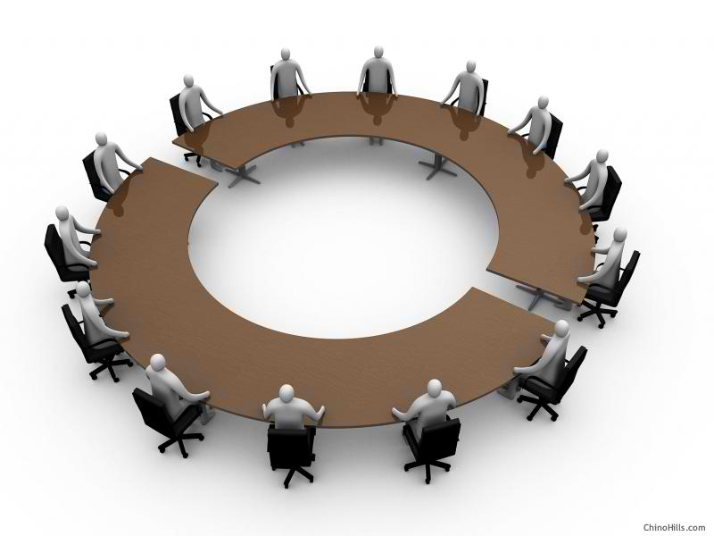
Identifying & Prioritizing Skills
Table Discussions
Consider:
Categories
Settings
Components
Stakes
OCA
*Place pictures, graphs and images here
http://www.starrkingschool.net/round-table-discussion/
1) Problem Framing Approach 2) Competencies 3) Assessment 4) Development

Slide 11
Assessing Communication Skills
We likely are going to have to assess dimensions of communication that we have not assessed before.
How have we done it traditionally?
Best practice drawn from other fields
Communication Field (OCC & OCA)
*Place pictures, graphs and images here
1) Problem Framing Approach 2) Competencies 3) Assessment 4) Development

Slide 12
Developing Communication Skills
What we expect:
Focus at the interesection of:
1) What is most important?
2) What is most deficient?
Balance systematic vs. differentiated
Solutions will likely include curricular, co-curricular, extra-curricular components built across the curriculum
Systematic instructor development will be required.
*Place pictures, graphs and images here
https://www.google.com/search?q=google+images&tbm=isch&gws_rd=ssl#tbm=isch&q=skill+development&imgrc=62r1dDav2Wjw2M:
1) Problem Framing Approach 2) Competencies 3) Assessment 4) Development

Slide 13
Next Steps?

Slide 14
The Grand Communication Canyon
Filling The Business Communication Skills Education Gap
Robert T. Sumichrast: Dean, Pamplin College of Business, Virginia Tech
Kevin D. Carlson: Associate Dean for Research & Faculty Affairs
Steve C. Matuszak: Business Communication Education Coordinator
Instructor, MGT Dept.

