Slide 1
Strategies for
Local Engagement and Global Reach

Slide 2
Local Enagement
Advisory Councils/Boards
Community Relationships:
Local Boards
Outreach Programs
Student Experiential Learning
Speakers and Speaker Events
Executives and Entrepreneurs - in Residence

Slide 3
The Robins School EAC
Other councils/boards
Membership
Meetings
Engagement
Financial Support

Slide 4
School External Board Service
Dean, administrators, faculty, staff service on local and national boards – board strategies
Engagement with local economic development, business, and partnership groups
Not-for-profit versus for-profit Boards

Slide 5
Student Experiential Learning – UR Robins CABE (FY17)
Field Projects – Student projects based on intensive interaction with a business or organization.
41 sections involved in Field Projects (712 students)
Class Activities – Course activities that include on-site visits to a business or organization and the use of practitioners to actively participate in classroom critiques or problem solving exercises.
34 sections involved in Class Activities (597 students)
Student/Faculty Research – 17 funded research projects
Internal Competitions
McWick Case Competition (233 students)
Business Pitch Competition (32 students, 21 teams)
External Competitions
National Team Selling Case Competition – Bloomington, IN (4 students)
CUIBE International Business Case Competition – Boston, MA (4 students)
CFA Research Challenge – Richmond, VA (5)

Slide 6
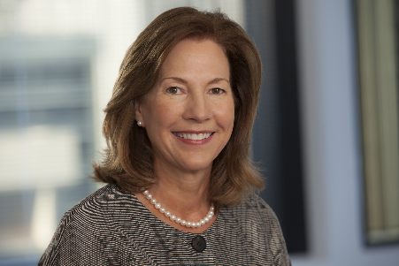
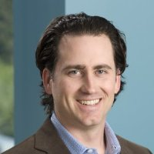
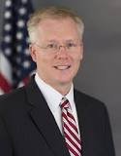
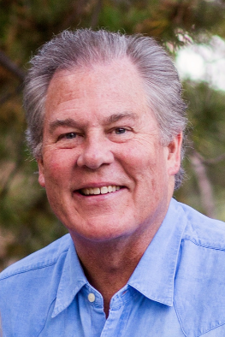
2017-18 Executive Speakers
Connecting
Word on Wall Street
October 5, 2017
Lynne Doughtie
US Chairman and Chief Executive, KPMG
September 21, 2017
Michael Walrath
Serial Investor, Founder, Advisor
Chairman of Yext
Spring 2018
Mike Piwowar (Watts Lecture)
US SEC Commissioner
February 6, 2018
Bill McDonald
(Retd) EVP Brand Management, Capital One
November 8, 2017

Slide 7
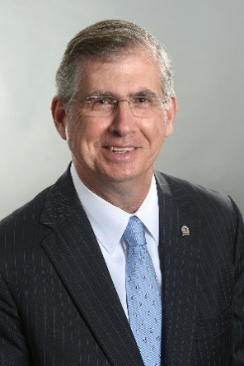
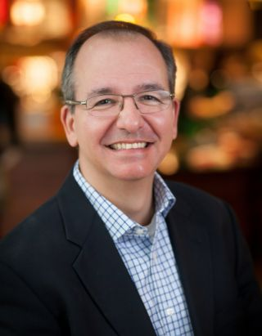
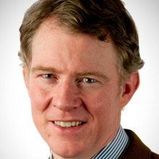
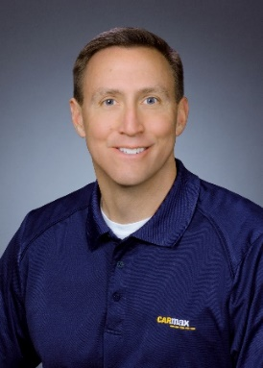
C-Suite Conversations
Connecting
MORE TO COME…
Bill Rogers
Chairman &
CEO, SunTrust
October 12, 2017
Beto Guajardo
Senior VP of Strategy
Starbucks Corp.
September 26, 2017
Tom Monahan
CEO, CEB Inc. (retd.)
February 13, 2018
Bill Nash
President & CEO, CarMax
November 15, 2017

Slide 8
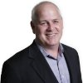
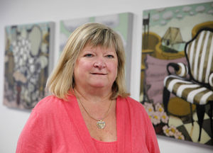
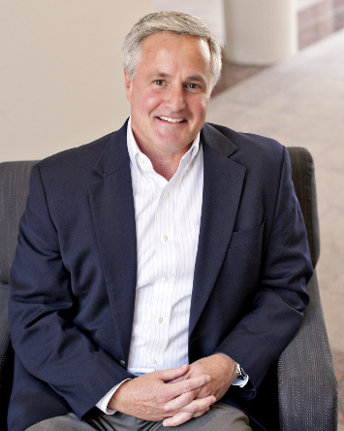
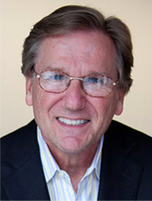
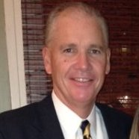
In-Residence
Connecting
Mike Page
Run Rate
Entrepreneur In-Residence
Katherine Busser
Capital One (ret) and
Virginia Children’s Hospital
Alliance
Executive In-Residence
Jim Brady
Marlin Equity Partners LLC
Entrepreneur In-Residence
John Adams
Martin Agency (ret)
Executive In-Residence
Tom Kemp
Lee Hecht Harrison(ret)
Executive In-Residence (MBA)

Slide 9
Global Engagement
Robins School Associate Dean for International Programs – manages relationships
Partner schools
MBA International Residency
Membership in CLADEA, EFMD, and AAPBS
PRME
Send faculty to international conferences, etc.
More!

Slide 10
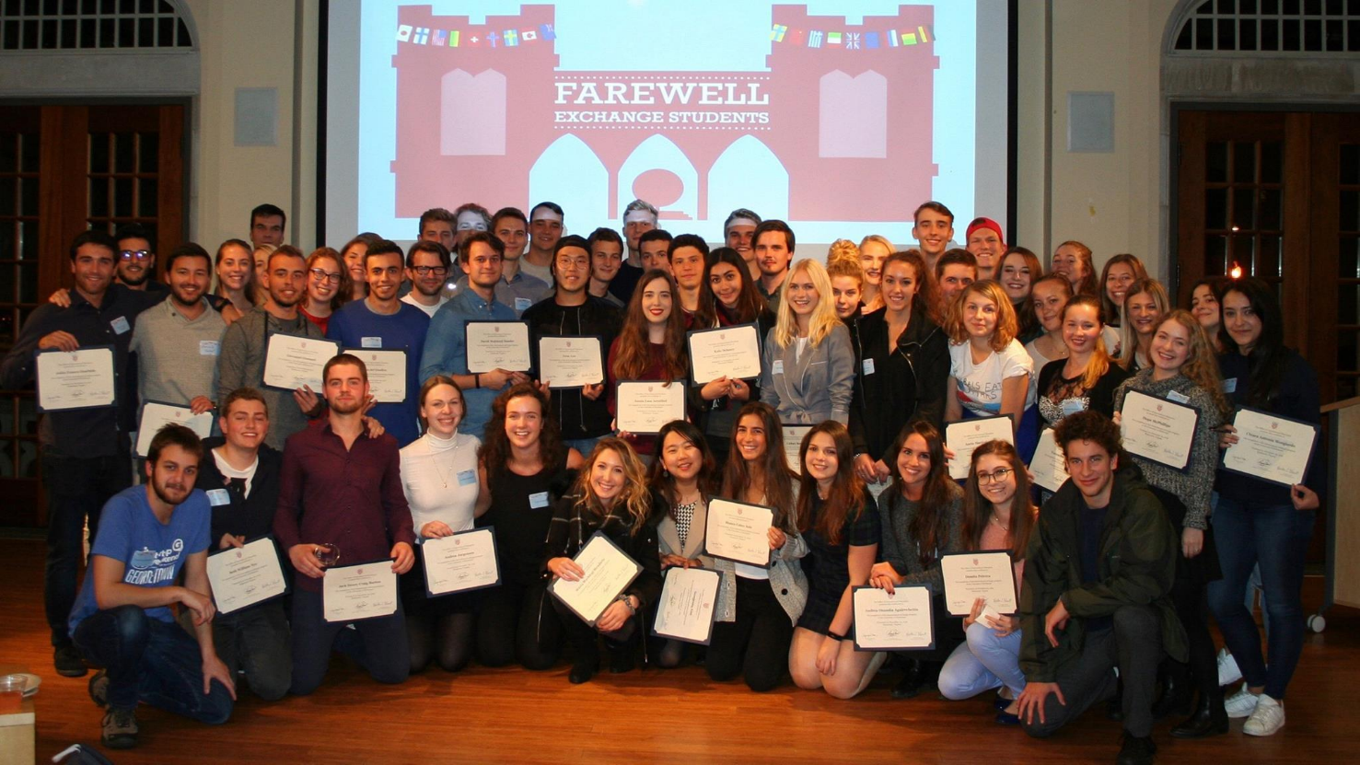
International Business
Study Abroad
Students out –
In Fall 17, 139 members of our junior class will spend the fall in 32 schools in 16 countries.
Students in –
Taking their place, we will welcome 47 students from 24 universities in 18 countries.
Fall 2017
Exchange Students
Notes:
The world is a scary place. We have 15 students studying in Barcelona this fall.

Slide 11
Study Abroad
Roughly half of Robins School third year students study abroad in the fall and 10 – 15 % study abroad in the spring. We are experiencing an increase in the number who study abroad in the summer – currently approximately 10%.
Robins Partner Schools
Argentina (2), Australia (4), Austria (1(), Brazil (1), Chile (1), China (1), Czech Republic (1), Denmark (1), France (4), Germany (2), Hong Kong (1), Hungary (1), Ireland, Israel, Italy, Japan, Mexico, Netherlands, New Zealand, Singapore, South Korea, Spain, Sweden, Thailand, Turkey, Taiwan, United Kingdom (England and Scotland)

Slide 12
Outgoing Students
VIDEO HERE

Slide 13
Incoming Exchange/Visiting Students
Each fall between 40 and 60 exchange/visiting students study.
Generally the Robins School accounts for the majority of exchange/visiting students on campus each year.
Students are fully integrated into the school – no special classes for them.
The are fully integrated in University housingl

Slide 14
Incoming Students
VIDEO HERE

Slide 15
MBA INTERNATIONAL RESIDENCY
2- 10 weeks abroad – one location
Work with local school versus 3rd party vendors to plan and coordinate in-country program
International Consultancy Project - 137 completed
Residencies held in Argentina, Brazil, China, Czech Republic, Croatia, Ecuador, France, Hungry, Mexico, Latvia,

Slide 16
Membership and Engagement in International Business School Organizations

Slide 17
Other International Engagement
Support and note faculty international travel
Hire international visitors
Encourage international collaborations in research and teaching
Ideas from the audience?

Slide 18
QUESTIONS?

