Slide 1
Ethics & Sustainability for the Global Impact Generation
SBAA Conference
July 2014
Leo Mackay
Vice President, Ethics & Sustainability

Slide 2
The Need: Leaders who…
Create impact with global relevancy
Appreciate practical ethics
Manage complexity through transparency

Slide 3
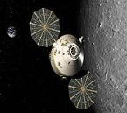
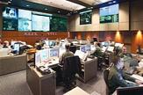
Lockheed Martin Perspective
Information Systems & Global Solutions
Missiles &
Fire Control
Mission
Systems &
Training
Space
Systems
Aeronautics
We solve complex challenges, advance scientific discovery and deliver innovative solutions to help our customers keep people safe and provide them essential services.

Slide 4
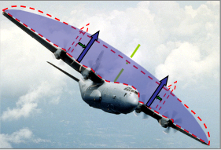
Needed: Global “Throw-weight”
Energizing Employees and Future Talent
Meeting and Exceeding Stakeholder Expectations
Reducing Costs and Improving Process Efficiencies
Risk Analysis and Opportunity Capture
Generate sustainable value, nurture global leaders

Slide 5
Global Impact relevancy factors
Capital Markets
Disclosure Rules
Natural Capital
Resource Depletion
Climate Analysis
Human Capital
Employee Loyalty
Lifecycle Costs
Risk Management
Access to Data
Investment Thesis
Extreme Weather
Global Citizenship Duties
Business Model Innovation
Greater pressure for managing total value chain impacts

Slide 6
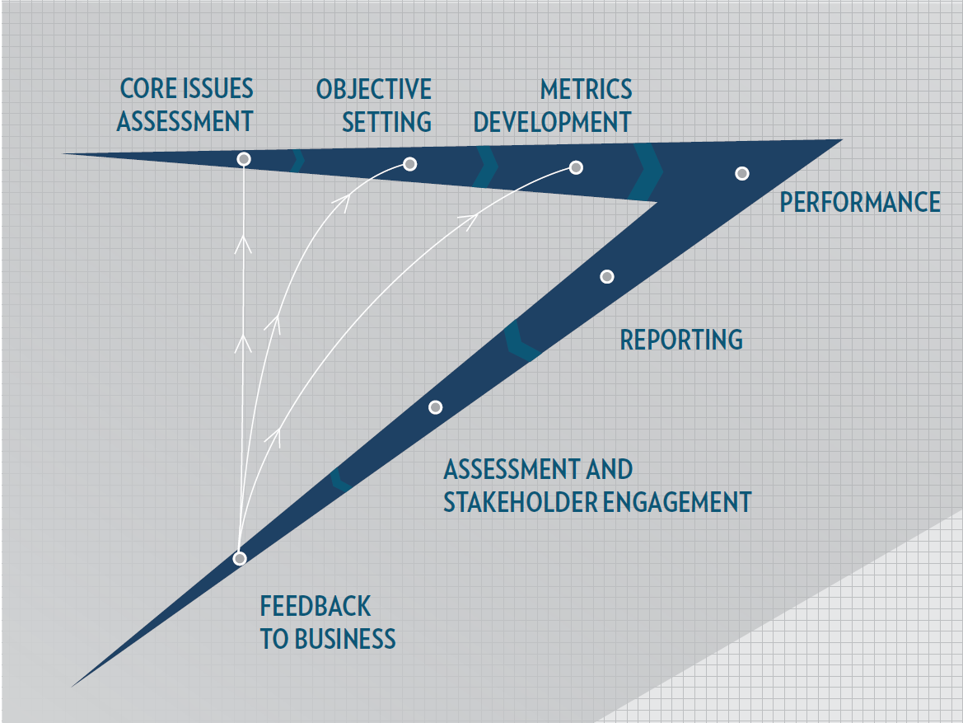
Managing Sustainability Progress

Slide 7
Global Defense Spending Migrating to Non-Traditional Markets

Slide 8
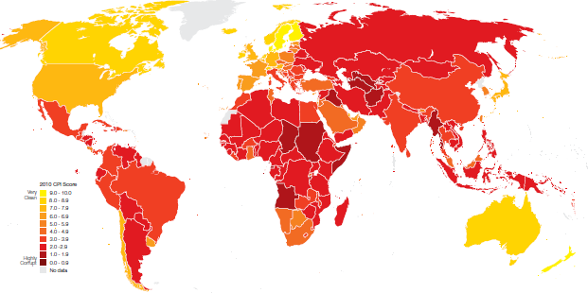
Transparency International Corruption Perception Index

Slide 9
Elements of Practical Ethics
Code of Conduct & Policies
Independent Structure
Outreach
Awareness Training
Monitoring
Compliance Training
Employee Survey
NOVA Ethics Award
Reporting Mechanisms

Slide 10
Enhanced Era of Transparency

Slide 11
More Disclosure, More Analysis
61%
Sustainability strategies necessary to be competitive
Source: 2010 and 2013 BCG-MIT SMR Sustainability and Innovation Survey
88
Industries to be covered by sustainability accounting standards by 2015
Source: Ethical Corporation
100
Median indicators disclosed in Corporate Sustainability reports across 10 industry sectors
Source: The Conference Board and Journal of Cleaner Production, Vol. 20, 2012.
88%
Corporate Citizenship important to decisions made by grad students, investment and purchasing professionals Source: The Conference Board Sustainability Practices 2013

Slide 12
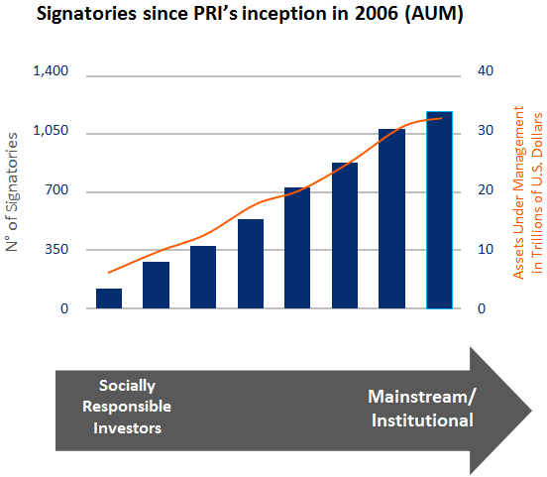
Enhanced Investor Calls
Markets Regulation
SEC Disclosure on Conflict Minerals and Cyber Intrusions
European Union Social Impact Disclosure Rulemaking
Voluntary Paradigms and Product Development
Principles for Responsible Investment in Farmland
Green Bond Principles
REDD+ Framework (de-forestation)
Impact Investing Fund Managers
Shareholder Activism
Human Rights
Political Fundraising
Carbon Divestment
Source: UN PRI

Slide 13
Molding future sustainable leaders
Integrity links to returns (How to embed practical ethics?)
Willingness to speak up and report violations
Agile thinkers manage complexity (How to innovate and win?)
Collaborate and harness stakeholder feedback
Act with total impact in mind (What factors to prioritize?)
People-planet-profit insights with best available data

