Slide 1
Agility and Vision for Rapid, Lasting Change in Business and Business Schools
Mike Clarke, (former) CEO, Access National Bank
Lara Khansa, Associate Dean, Pamplin College of Business
Robert Sumichrast, Dean, Pamplin College of Business
Notes:
RTS Intro---this will probably be done by the “facilitator.”
I am here with Mike Clarke and Lara Khansa
Mike is a Virginia native and graduate of VT’s b-school. He began his career in banking. About 20 years ago, Mike became an entrepreneur starting Access National Bank which grew and prospered even during the financial crisis of 2008. Mike was able to a range for Access to merge with Union National bank earlier this year in a transaction valued at $610M. Now Mike is a member of the board of the resulting company, Atlantic Union Bank.
VT’s motto is Ut Prosim which we translate as “that I may serve.” Mike has lived his life in accordance to Ut Prosim including his service to his community and his service to VT.
Lara is VT business AD for UG and Professor of BIT. In addition to an academic background in finance, information systems and engineering, she worked as a software development engineer for GE. Lara has been important to Pamplin’s and VT’s most innovative projects and in strategic planning. Despite her admin role, she has remained an active researcher who routinely publishes in some of the top journals in her field.
--------------------
The theme of our talk is that big changes often take time to implement and over time the environment changes. If you have a good important idea, you may need to change the details but if you retain your vision, you may be able to accomplish things that have a positive impact, long into the future.
First, Lara will provide a theoretical background that helps guide actions for change. She will also provide some general findings about creating environments that foster deep learning and agile workforce development.
Next Mike will share his vision for community banking and provide personal examples of how he was able merge his bank and further his vision.
Finally, I will provide an example of developing a vision for business school facilities and adapting to environmental changes to bring the project to completion.

Slide 2
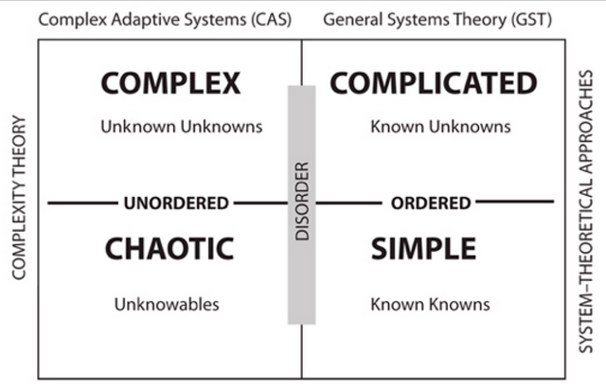
Agile Leadership for Long-Lasting Change
The Cynefin Framework
(Kurtz & Snowden, 2003)
Notes:
Simple systems:
Cause and effect relations ae repeatable, perceivable and predictable; legitimate best practice; standard operating procedures; process reengineering.
Decision making strategy: Sense-Categorize-Respond
Complicated Systems:
Cause and effect separated over time and space; analytical/reductionist; scenario planning; systems thinking
Decision making strategy: Sense-Analyze-Respond
Complex systems: Cause and effect are only coherent in retrospect and do not repeat; pattern management; perspective filters; complex adaptive systems
Decision making strategy: Probe-Sense-Respond
Chaotic systems: no cause and effect relationship perceivable; stability-focused intervention; enactment tools; crisis management
Decision making strategy: Act-Sense-Respond
Include: know the past to understand the environment. Mentors are important to understand the past.
Include: importance of vision to keep things in perspective
Good leaders embrace change at an individual level. Adept leaders will know not only how to identify the context they are working in at any given time but also how to change their behavior and decisions to match that context. Successful leaders prepare their organizations to understand the diverse contexts and the conditions to transition between them.
Throughout this process, leaders need to stay focused on their vision and be able to other shareholders. They also need to understand the past with the help of mentors so they can make more informed decisions for the future.

Slide 3
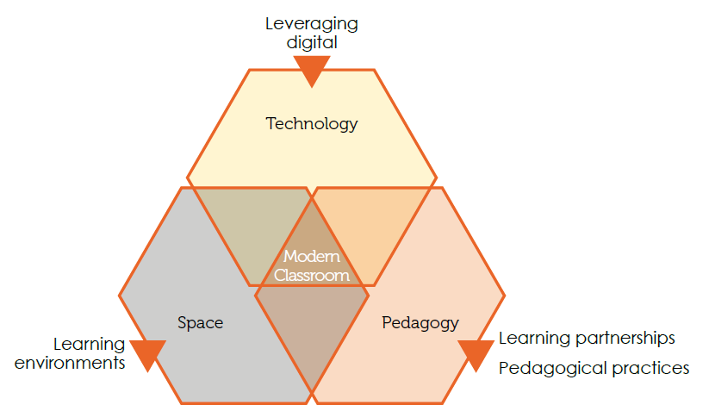
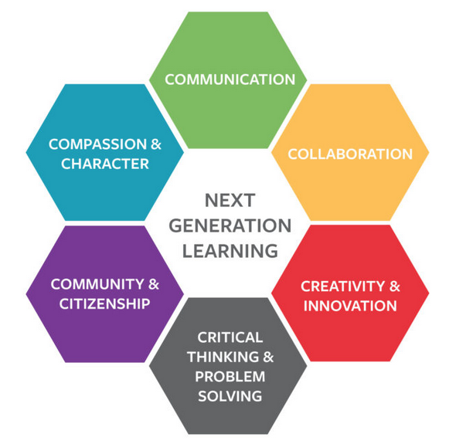
Agile Business Education for Workforce Agility
The Six Cs of Deep Learning
(Fullan & Scott 2014)
The Modern Classroom
(Fullan & Scott 2014)
Notes:
According to New Pedagogies for Deep Learning (a global partnership of researchers, families, teachers, school leaders and policy-makers), every student needs 6 core skill sets to achieve ‘deep learning’, so that they are prepared to excel in today’s complex world. The following are considered necessary skills in the 21st century:
Collaboration
Creativity
Critical thinking
Citizenship
Character
Communication
This deep learning is achieved through a balance of:
Learning partnerships – cultivated between and among students, teachers, families and the wider environment
Learning environments – fostering 24/7 interaction in trusted environments where students take responsibility for their own learning; engaging; Social and collaborative; Participatory; open; flexible
Leveraging digital – accelerating student-driven access to knowledge beyond the classroom; environment needs to be digital, mobile, connected.
Pedagogical practices – for designing, monitoring and assessing learning; experiential learning
Pedagogical innovation demands a space that enables exploration by both teacher and student. To be effective, this space should allow for multiple modes of instruction and learning
The Future Classroom is an open space divided where the students face different problems, different equipment and different technologies in order to answer a question posed by the instructor. It is inquiry based learning.
Introduce Mike as an entrepreneur in the financial industry

Slide 4
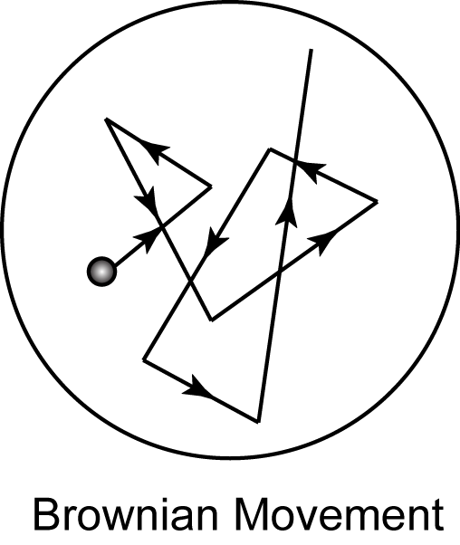
A Vision for Community Banking in the Face of Disruptive Change
  Mike Clarke, (Former) CEO, Access National Bank
Notes:
Lara—transition to Mike. Connect theory to his practice.
Mike will describe community banks and his vision for community banking. He also describes some of experiences with disruptive changes and opportunities to achieve that vision.
**************
I think I was asked to join in this presentation as there are parallels in the business of banking and higher education. And there may be elements of my experiences that could be beneficial in shaping your views and plans of the changing landscape. Both industries have long standing “traditions” and, until recent years, main stream participants have been slow to accept change. Change is being forced on many operators due to an evolving society, environment, accelerating innovation and the threat of non-traditional competitors.
As a young college graduate in the early 1980’s, I entered an industry that had over 18,000 participants. The unintended consequences of public policy and the realities of an evolving economy has shrunk that number during my career to just over 4,500 today. As the number of banks have shrunk and economy evolved, it has never been more important for banks to be mindful of two important issues: 1) Differentiate your brand and service offering; and 2) Monitor an adapt to the ever changing environment. The companies that have failed to pay attention, faulter and lose the confidence of their key stakeholders: most important – customers and then investors.
In the early 1980s most banks operated in very similar ways and had very similar offerings. The long term survivors today and going forward have a far more deliberate and unique positioning within their desired market.
As a country, the unique structure of our banking system is one of the key reasons the USA is a hot bed of innovation and home to more small businesses and than other country around the globe. In spite of many innovations intended displace the traditional bank, banks are the primary source of capital for business. For those not familiar, we are unique in that we have over 4,500 banks while most countries only have one nor a handful of banks. Take Canada for example where there are 4 banks.
Capital is the life blood of business and banks enable the circulation and allocation of capital that provides a key foundational element to economic and business health. The best way to illustrate this is to drive through small towns inn rural America. The towns that seem to be struggling the most, lack a bank focused on serving local businesses. I am not suggesting banks create economic development and prosperity, but they are a vital ingredient. As you can tell, not only has my career enabled me to provide for my family, it’s given me a strong sense of purpose.

Slide 5
Changing landscape
High barrier of entry (regulatory approval, capital)
Rising cost of playing the game (overhead)
Number of players decline by 75% over life cycle (18,000 – 4,500)
Top 6 players control 85% of the market
Gross profit margins decline 40% over 20-years (5% - 3%)
Required capital will rise 50% over the next 20-years
Alternative public investments generate 20 – 30% returns
Notes:
Passion alone can’t create success. When we started our bank in 1999, our industry had been through a lot of consolidation and change and there was plenty more to come. In addition to the shrinking universe of participants and diminished likelihood of success, we faced other hard realities that are noted in this chart. Most of them are financial as a good financial plan is at the core of any good business plan before we pass GO the first time and start our journey.
These head winds required us to think out of the box to create a business plan that mitigated or averted the main pressure points and deliver a financial plan that would be compelling. The key to our financial plan was to exploit the operating and financial leverage that is unique to banking. We sought to scale a larger financial entity on top of a smaller and more lean overhead operation compared to the “traditional” path most banks took.
Like many new businesses, the catalyst to start our new bank was the sale of a bank where I was Chief Credit Officer to an out of state operator. The bank that sold was successful and investors approached me to put their capital back to work by starting a new bank and doing it better. I rounded up the core bankers and together we created a plan to mitigate the growing risks we foresaw while staying true to core traditional banking principles that would compel investor support. We spent a fair amount of time crafting a unique plan but to be serious, we needed capital and a bank charter. To launch our bank, we needed $10 million of capital that was raised though friends and family of the organizers. But where to start and how did we find an inflection point? ……………………….Skip and the lawyer.

Slide 6
Access National Bank: Mission and Vision
Our mission is to provide on-target and superior financial solutions to the client we serve.
All of our endeavors must enrich the interest of our clients, shareholders, associated and communities.
Our vision is to be the leading provider of banking services to affluent individuals, middle market businesses and associated professionals with a geographic focus on the Washington DC MSA.
Notes:
Any good business plan requires a directional compass provided by the mission and vision statements which are shown here. While a lot of this may look similar to what you might find at other companies, they key for us was to have a relentless obsession with staying true to the mission and underlying values. I’ve seen a lot of companies compromise their mission or vision because of industry tradition or because the guy across the street is doing it. In my experience, when you let a competitor drive your products or pricing, you end up being as good as your weakest competitor.
So what do I mean by that? I am sure everyone here interacts with a bank and has your perception and experiences. The best way to illustrate our commitment to an operating plan clearly tied to our financial plan commitment is to look at some tactical elements of how we operated.

Slide 7
A Challenge to Banking Conventions - circa 1999
Design a better client experience!
Targeted client selection
Personalize account management
Automate / self-help routine service
Reduce foot traffic in branches
Reduce staff & improve professional caliber
Avoid elevated risk or weak profit margins
Clearly communicate competencies in product and industry (clarity about what we avoid)
Notes:
Our business starts with the customer. But we didn’t want just any customer. We’re a business bank. So we segmented the market by NAICS codes and chose those industries that would find our operational strategies attractive and that we were sure we would make money at.
In educating our staff and the market, it was important that we be very clear about what kind of business we desired and equally clear about what we did not want. We did that through a coding system that all staff was required to use.
Next we only offered products and services that delivered our desired financial results. That means we sometime suggested clients use another bank for non-core services we didn’t find profitable.
How about a couple examples you can relate to:
ATMs. We didn’t own a single one even though we handled the primary accounts for a lot of business owners and high net worth people. We actively informed our clients it was more attractive to us and more convenient for them if they use the ATMs of any other bank around the globe and we pay the fee.
Branches. We had about 75% fewer branches than most banks our size. We searched for ways to deliver service and convenience remotely and personally that kept customers out of the branch. They kept real estate costs down, aggregate personnel cost down. Part of what we saved in reduced staffing, we spent in caliber of staff and the latest and best technology we could afford.
Drive Ins. We didn’t have any. What happens at a drive in? You drop off deposits and cash checks. Why bother? You can deposit a check electronically through a mobile device with ease from your home or office. If you need cash, use the nearest ATM. Or better yet, use a debit card or electronic payment mechanism.
Of course I can go on all day about this stuff but let’s move on to something fun – like financial distress!

Slide 8
Community Banking: Crises and Setbacks
What we need is a good recession!
nearly 500 banks fail – why?
Government bail out TARP – the court of public opinion
Adversity tests everyone and purges the weak
Be weary of unaligned stakeholders
Adversity offers an opportunity to strengthen plans/ resolve
Notes:
In the quarters leading up to the financial crisis, I would joke with my fellow managers that we needed a good recession to wring some foolish activity out of the market. I had no idea how big I got what I would ask for. Our bank performed well during the recession. We made money every quarter and we did not take government bail out money. We did well because we stuck tried and true investment fundamentals concerning credit underwriting, concentration and risk management. We used the recession as time to re-engineer some elements of our business that payed enormous returns in creating value for our shareholders.
While our banking was doing fine, our industry got saddled with the public perception that we caused the financial crisis. Small banks were viewed as risky has hundreds failed. Meanwhile, the government bailed out large banks and investment banks that were too big too fail. We had to “go on the offensive” to explain to our clients and communities that we were OK and not the villains portrayed in the media.
Given our strong financial performance, I was taken by surprise to get pressure from investors to make changes in our business and follow the herd. Of course we all know the housing segment was at the core of the crises and we owned a sizable mortgage company. It was performing fine. But some investors had a hard time believing that and wanted us to exit the business like everyone else was doing. The only difference is that the “everyone else” was losing money and we were making money. Long story short, we stayed true to our core competency and vision. We made a deliberate decision to stay in the business. That decision precipitated some of our large public investors to sell their shares so much so that it drove our stock price down by 75%. I was not popular but knew it was the right thing to do. There is a silver lining. Once we got accustomed to the low stock price and realized we had strong earnings from the mortgage business, we used those profits to buy shares off the market and accelerate wealth creation for the remaining shareholders.
Like bank operations, I can speak about the financial crisis for hours. But lets wrap this up with a reminder about marketing and sales.

Slide 9
Never Give Up on Marketing and Sales
Most believe sales is evil or beneath them
Ability to sell should be trait #1
Those that generate revenue make more money!
Everyone sells – products, ideas
Let me show you I can sell (even when you don’t expect it)
Am I selling or helping? (now you need me!)
Notes:
I don’t care if you run a bank, a business school or a hot dog stand. Revenue drives the train. In this changing world, it seems everyone is looking for a short cut to generate volume and revenue. I’ve always found that young professionals in our industry don’t want to get involved in sales but they want to be an executive and have a big book of clients or run the company. What they fail to realize is that to be successful in their trade, they have to sell. It may be ideas they are selling. Or good services that uncovers a new revenue opportunity. The fact is, ALL of us and our staff must drive and contribute revenue. It starts at the top, where the buck stops.
As I have gotten to know Robert Sumichrast, I know he’s a guy who believes in driving revenue and engagement from the top. A few years ago the leadership of Virginia Tech embarked on a search to find a leader who could take a business school to the next level. That’s how I met Robert and it wasn’t long before he crafted a new business plan for our college deigned to do just that. We were impressed by his experiences and background in transforming the business schools at 2 of his prior roles and we were most impressed with his accomplishments while at the University of Georgia.

Slide 10
Stick with the Vision; Change the Details
  Robert Sumichrast, Dean, Pamplin College of Business
Notes:
Mike transitions to Robert
Hired Robert from UGA. Knew some of his track record.
Just as Mike brought innovation to banking, Robert brought innovation to the business school.

Slide 11
Transforming the b-school at VT
Vision: a leader in business education, developing knowledge and … recognized by companies that employ our graduates and by individuals at influential universities.
Focus on areas where excellence is possible
Funding to achieve the vision
Faculty must fit
Facilities can promote or inhibit success
Notes:
Vision from Pamplin Strategic Plan 2014
The four F’s. Later told that an “F” in education is not a good thing.

Slide 12

Pamplin Hall
Constructed 1957
Expanded 1988
Lacks
  Collaboration areas
  Specialized classrooms
  Space
Notes:
Pamplin Hall is lacking
I had led the development of new facilities for LSU and UGA while I was dean at those universities. At LSU, I had the vision but the design was changed significantly after I left. At UGA, the design I worked on was largely felt in tact and will be ceremonially opened this September.
I knew from theses experiences how developing business school facilities could qualitatively change research, educational programs and the culture of a college.

Slide 13
The Business Learning Community
Multi-building concept
  Commons
  Classrooms
  Teams, mentors
  Student services
  Residential space
Notes:
Agile student learning. Able to adapt to changing environment.

Slide 14
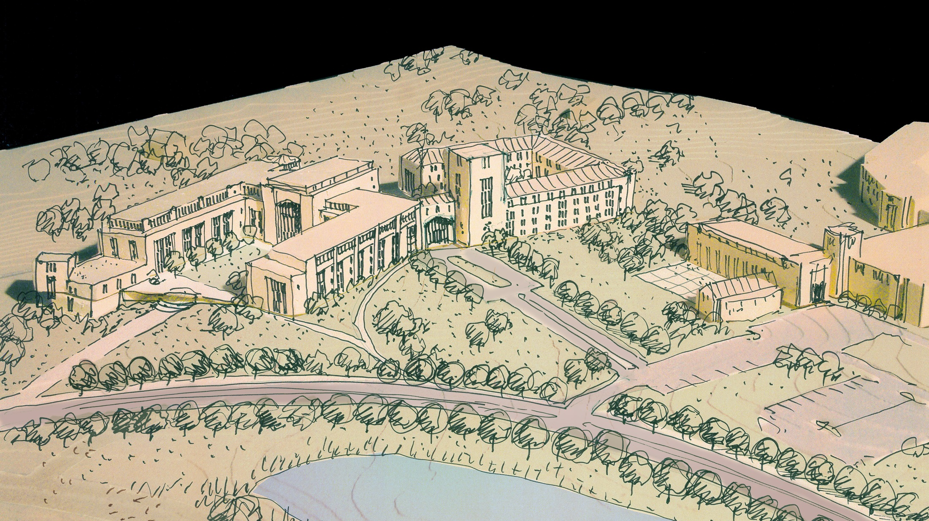
Site 2, Option 2

Slide 15
The Business Learning Community
$160M
How do we pay for it?
  State
  Fees/auxiliary
  Private investment

Slide 16
Instant high priority—until …
New president
New provost
Planning with dorms, recreation and dining
Infrastructure cost skyrockets
Choices
  Give up
  Small alumni financed project
  Become priority
Notes:
Encountered changing environment. Kept the vision

Slide 17

Global
Business &
Analytics
Complex
Notes:
Emphasize concepts that the pres and provost thought important. (Not creating new concepts—just enhancing and improving.)

Slide 18

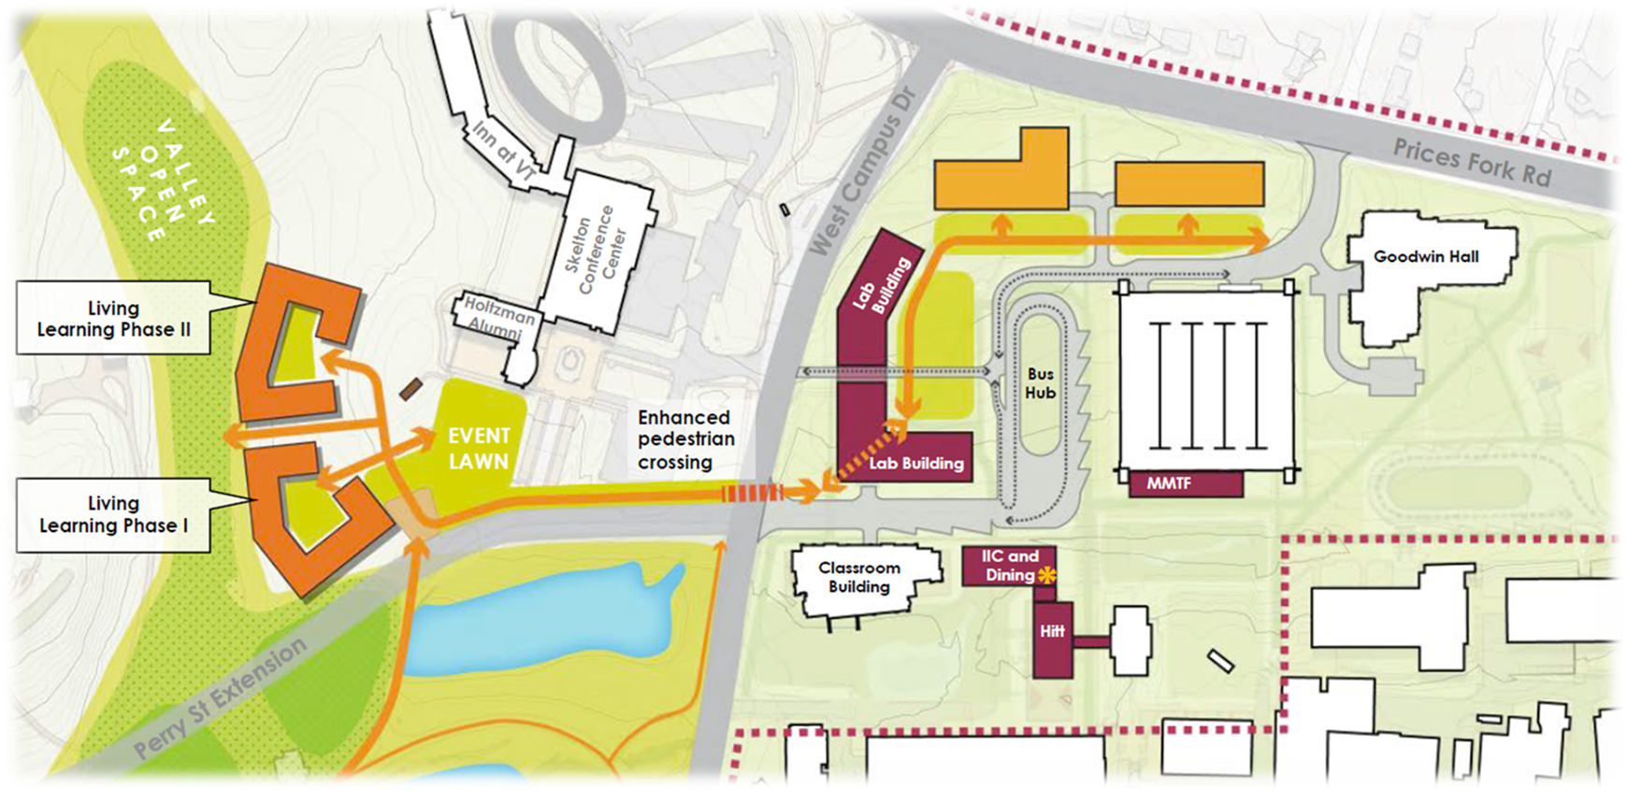
GBAC
4 buildings
350,000 GSF
$250,000,000
Catalyst

Slide 19
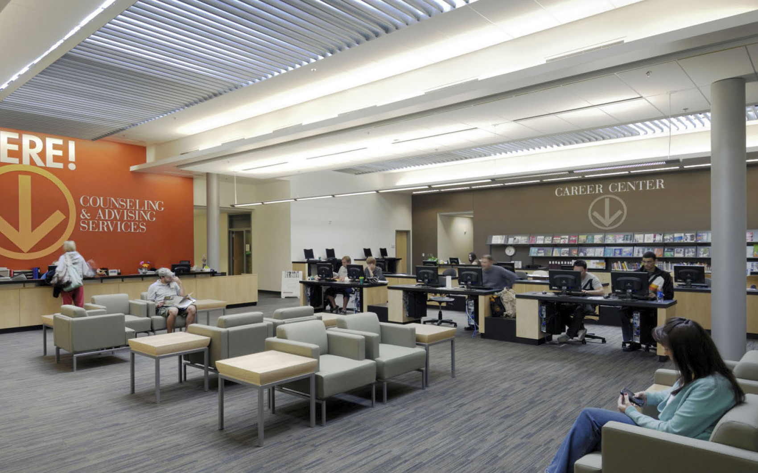
GBAC as a Catalyst
Programs
Best students and faculty
Expanded talent pipeline
Notes:
Research and learning

Slide 20
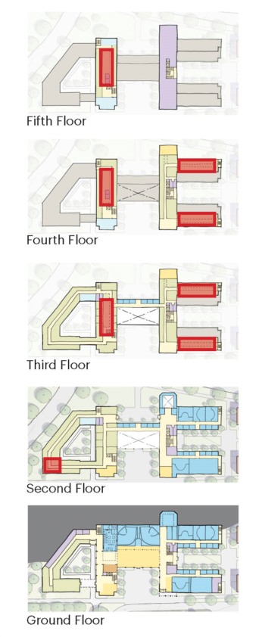

Collaborative Space:
Student–Professor Engagement
Notes:
Complexity

Slide 21
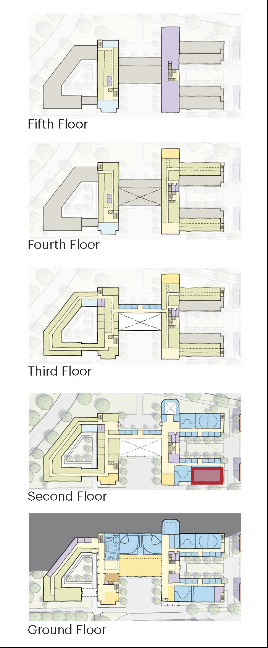

Enhanced Learning: Sales/Behavioral Lab

Slide 22
Can we do it?
GBAC Committed and Required
Private

Slide 23
Can we do it?
GBAC Committed and Required
Private
BOV

Slide 24
Can we do it?
GBAC Committed and Required
Private
BOV
State
VT

