Slide 1
MICRO-CREDENTIALING: The Do’s and the Don’ts
Sri Beldona & Brett J. L. Landry
2019 SUMMER WORKSHOP

Slide 2
WHAT ARE MICROCREDENTS?
The answer really varies

Slide 3
DEFINING MICRO CREDENTIALS
Digital Badge
Digital badge that recognizes demonstration of a competency based on evidence assessed and validated by issuing organization
Issued by an organization, embedded with metadata including the achievement assessed and evidence of achievement
Competency Based Micro Credential

Slide 4
GRADUATE LEARNING PATH
Courses
Badges
Certificates
Degrees

Slide 5
MOOCS
Full Masters
Micro Masters
(50K – Free)
(1500 – Low Cost)
University of Edinburgh

Slide 6
DIGITAL BADGES
REWARD AT EVERY STEP

Slide 7
What are digital badges?
Badges are digital assets used to communicate a learning achievement or credential. They link to metadata that provides context and verification. They can be shared across the Internet for maximum visibility and recognition.
Badges are a standard to recognize and verify learning. A badge communicates three things about the earner and their achievement:
Who did something?
What did they do?
Who says they did it?

Slide 8
STICKERS $≠$ BADGES
Successfully Walks and Chews Gum

Slide 9
STICKERS $≠$ BADGES
X
Successfully Walks and Chews Gum

Slide 10
WHAT other UNIVERSITIES ARE USING DIGITAL BADGES?
Georgetown
George Mason
Incarnate Word
Northeastern University
Notre Dame
University of Texas – Austin
Western Michigan – Hawthorn College of Business
Santa Barbara City College
University of Utah

Slide 11
HOW ARE BADGES VALUABLE TO THE EARNER?
Tell their professional story in a way that is credible and validated
Share a verified achievement
with their personal and
professional networks
Access real-time labor market insights and jobs related to their skills
Access learning pathways

Slide 12
HOW ARE BADGES VALUABLE TO UD?
Drive increased brand
exposure through
organic sharing activity
Connect our program with career opportunities through Acclaim’s labor market insights
Create learning and professional pathways to encourage individuals
to progress forward
Increase credibility by providing verified, trusted recognition

Slide 13
The badge process
Issuer develops
badge metadata
Earner meets requirements
Issuer issues
a badge
Earner
accepts badge
Earner
shares badge

Slide 14
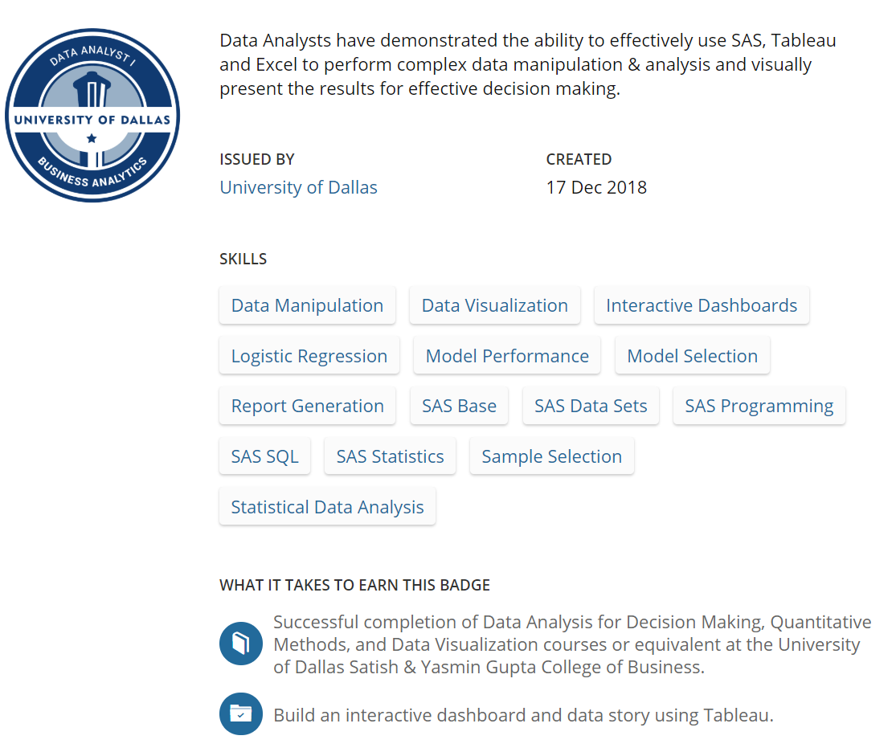
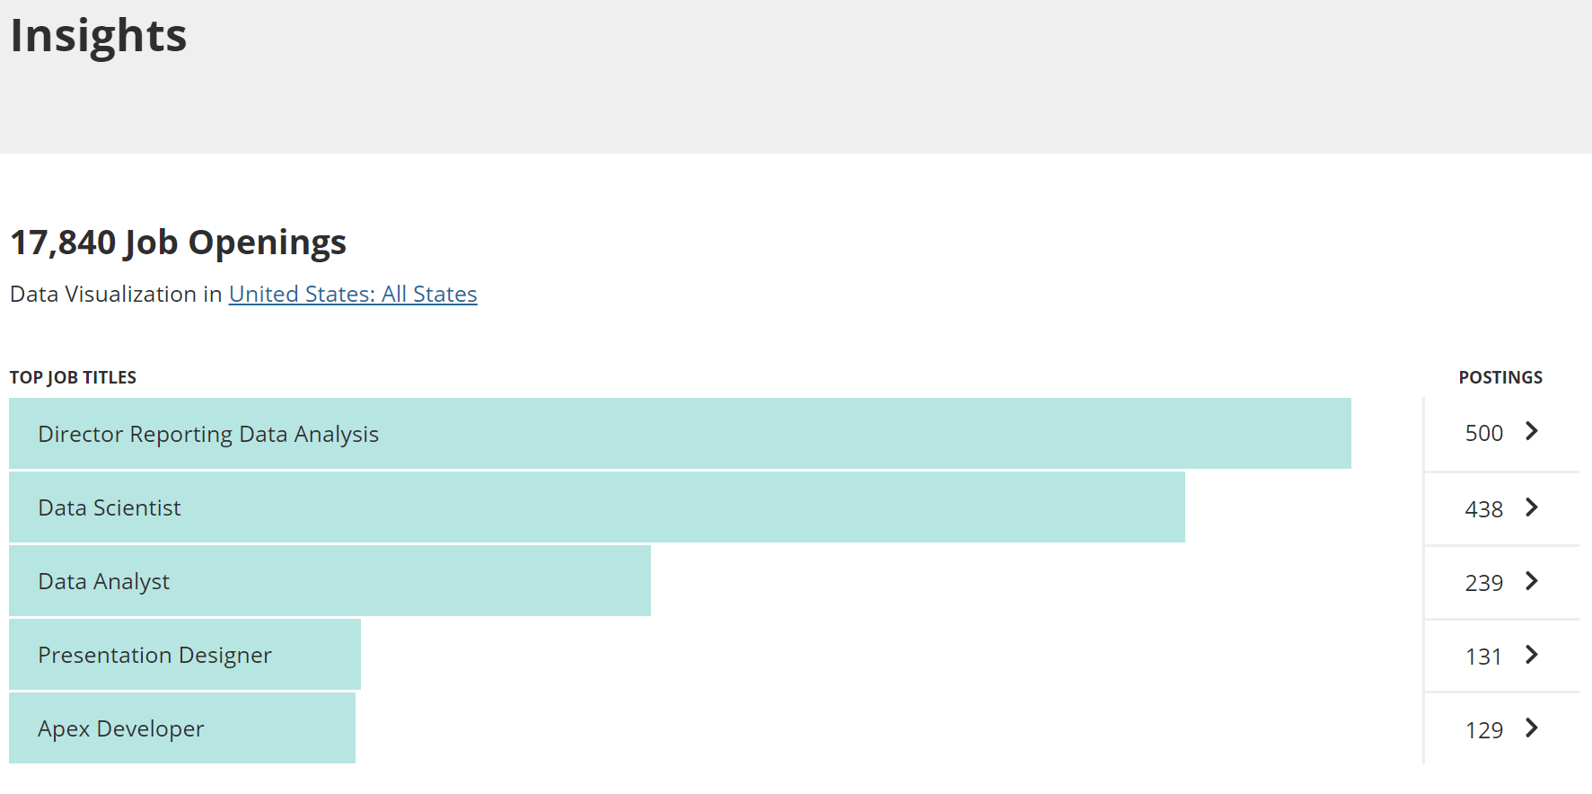
Labor Market Data: Real-time Feedback

Slide 15
The development process
Faculty and staff meetings
Building badges exercise
Decoupling the degree
Meeting with various chairs/program directors
Building the badge – the artwork and the meta data
Presenting the badge design and metadata to various stakeholders
Announcing the badges to the student body

Slide 16
DIGITAL BADGE COMPONENTS
Badge Image
(.png)
Badge Metadata
(structured data describing the achievement)

Slide 17
Badge design - graphics
Recognizable
No explanation needed
Easy to read as a small image
Expandable to entire University

Slide 18
SANTA BARBARA CITY COLLEGE
WHAT DO THE ICONS
MEAN?

Slide 19
AGILE
??????

Slide 20
TERADATA
WHAT DO THE SHAPES AND COLORS MEAN?

Slide 21
IBM
WHAT DO THE SHAPES MEAN?

Slide 22
Arizona State University
WHAT DO THE SHAPES MEAN?

Slide 23
Advocate
Explorer
Practitioner
DO THE CIRCLES CONVEY LEVELS, EFFORT, OR DURATION?

Slide 24
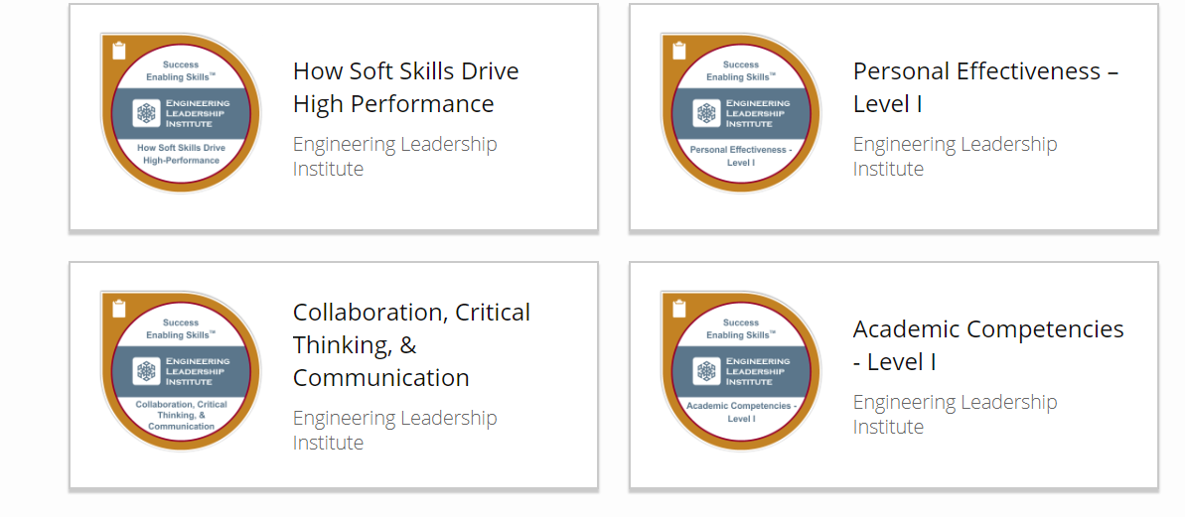
LEVELS MENTIONED IF USED

Slide 25
What does “Learn” Mean?

Slide 26
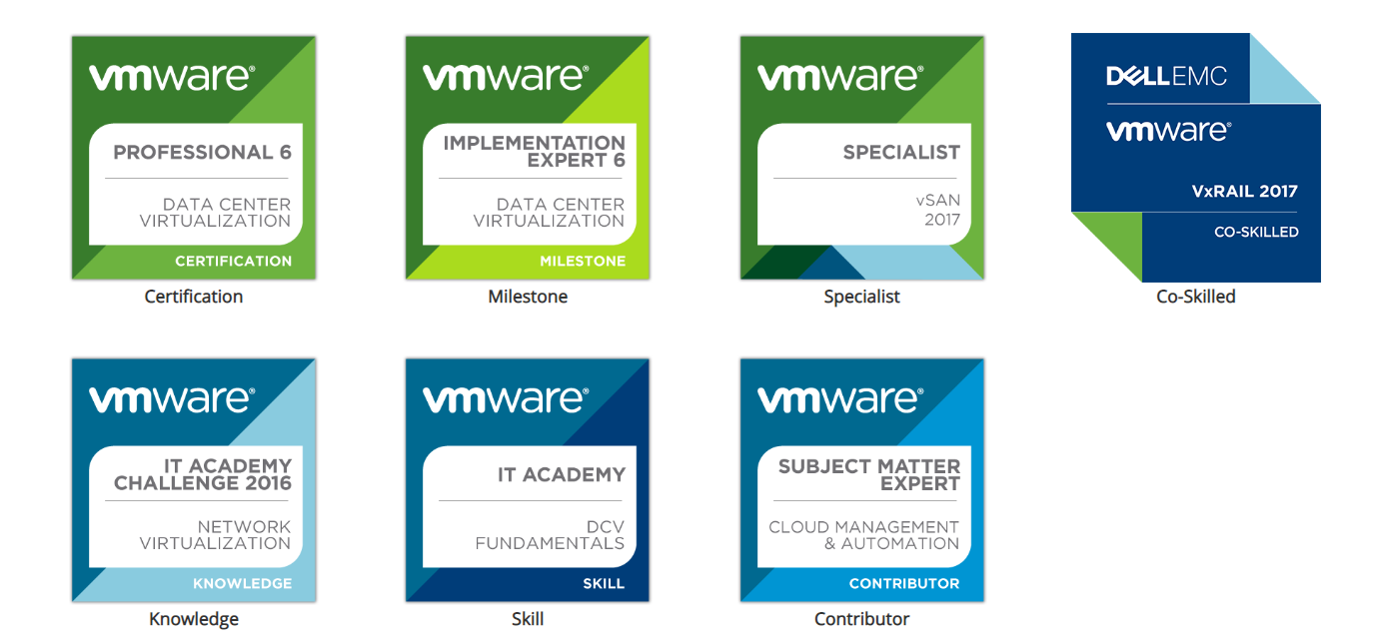
VMWARE
CERTIFICATION
MILESTONE
SPECIALIST
KNOWLEDGE
SKILL
CONTRIBUTOR
CO-SKILLED

Slide 28
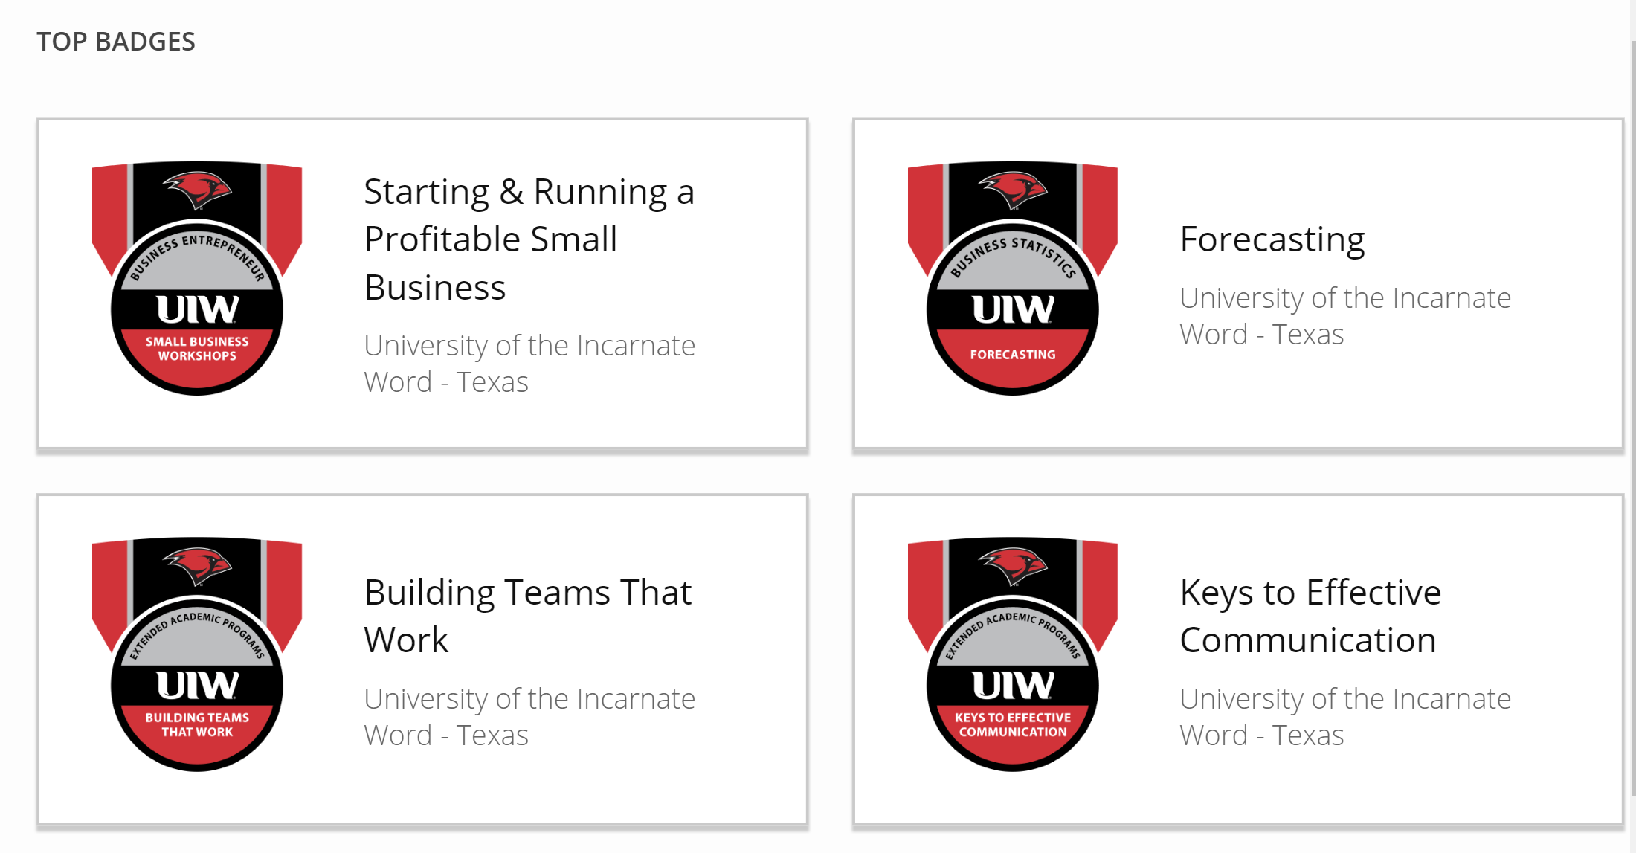

Slide 31
DIGITAL BADGES
REWARD AT EVERY STEP

Slide 32
Badge Metadata
Badge Name: This is the name of the badge, course, certificate, or competency
Description: Describes the outcomes of this achievement and articulates what the individual is capable of or competent in doing
Skills: Keyword phrases that describe the skills the learner has acquired or demonstrated and link to labor market data
Criteria: Describes the sequential set of steps required in order to earn the badge
Issuer: Brand standing behind this badge and validating the achievement
Recipient: Name and email address of the earner
Issued on / Expires on: Date the badge was earned and when it expires (optional)

Slide 33
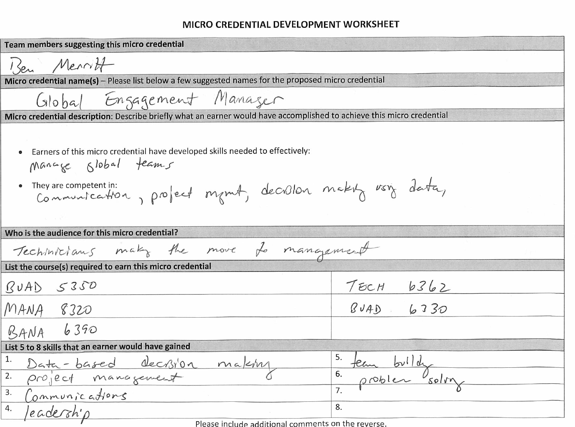
BUILD A BADGE WORKSHOP

Slide 34
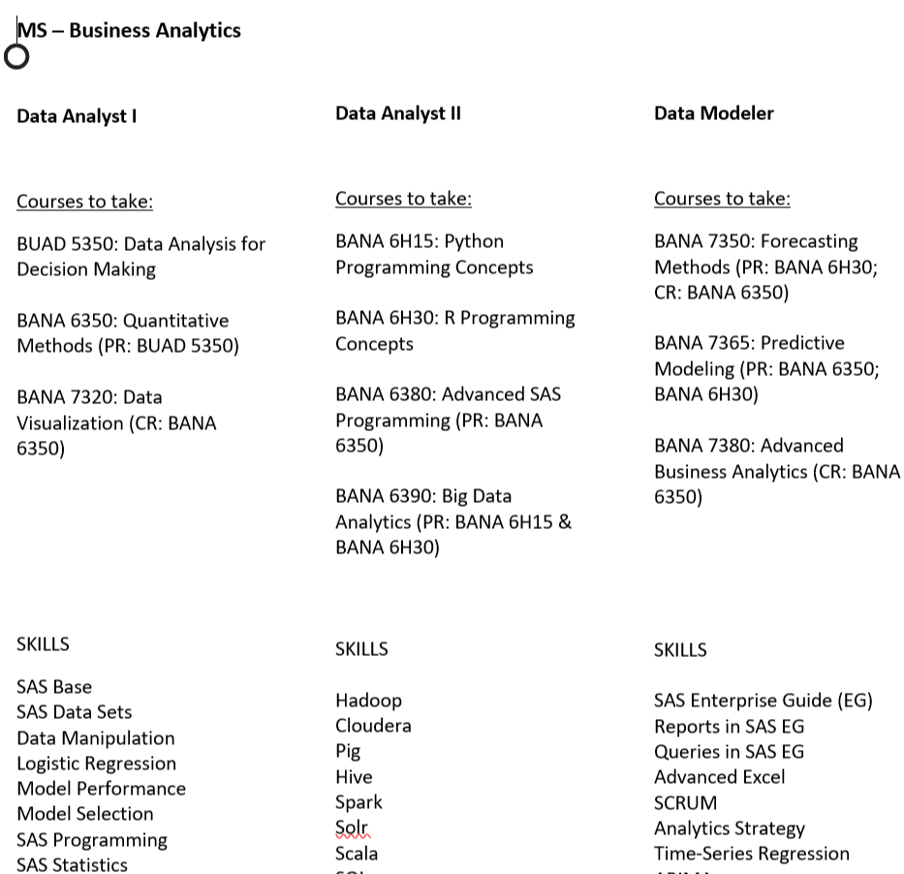
Decoupling the degree – MS in Business ANALYTICS

Slide 35
MS in Business Analytics – the badges
Data Analyst I
Data Analysis
Visualization
Data Analyst II
Big Data
R & Python Programming
Data Modeler
Forecasting
Advanced Business Analytics
Quant Methods
Advanced SAS
Predictive Modeling
MS in Business Analytics

Slide 36
BADGES ARE NOT SINGULARLY RELATED
DISCIPLINE
l
Course 1
Course 2
w
Course 3
DEGREE
BADGE
COURSES

Slide 37
BADGES CAN INCLUDE MANY DISCIPLINES AND COURSES.
COURSES CAN BELONG TO MULTIPLE BADGES
DISCIPLINE 1
Course 1
Course 2
w
Course 3
DEGREE
BADGE
COURSES
l
DISTINE
DISCIPLINE 2

Slide 38
Summary
Badging technology allows individuals to tell their professional story online with verification in a single click.

Slide 39
MICRO-CREDENTIALING: The Do’s and the Don’ts
Sri Beldona & Brett J. L. Landry
2019 SUMMER WORKSHOP

